Slide 1

www.tweakteach.com
©2025 TweakTeach

Slide 2
THE ZHOU DYNASTY
To study the main features and the rise and fall of the Zhou Dynasty
Key Phrase – Mandate of Heaven: Heaven will grant the King
legitimacy based on the prosperity of the Kingdom.

Slide 3
Shang Dynasty Collapsed in 1046
The Zhou Dynasty rose to power and ruled for eight centuries by defeating the last king.
The Zhou Kings Wen and Wu, as the myth goes, witnessed supernatural events that meant that the mandate of heaven had passed to the Zhou.
King Wen, assisted by his able minister Yu, began the conquest of Shang, which was later carried out by Wu
On your worksheet, fill out the appropriate section.

Slide 4
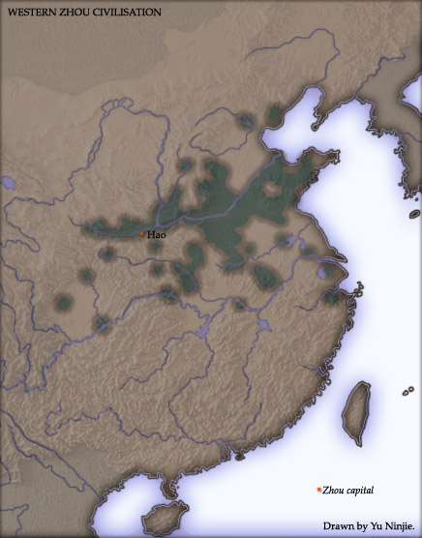
The Dynasty is divided into periods - The Western and the Eastern Zhou Dynasty
The Western Zhou had its capital in the west in the Wei River Valley
The Eastern Zhou began in 771 BCE when the dynasty had to move to the east to the present-day city of Luoyang in the Yellow River Valley
Wikimedia: The Zhou Dynasty with the capital marked as a red dot
Notes:
https://commons.wikimedia.org/wiki/File:China_2a.jpg

