Slide 1

www.tweakteach.com
©2025 TweakTeach

Slide 2
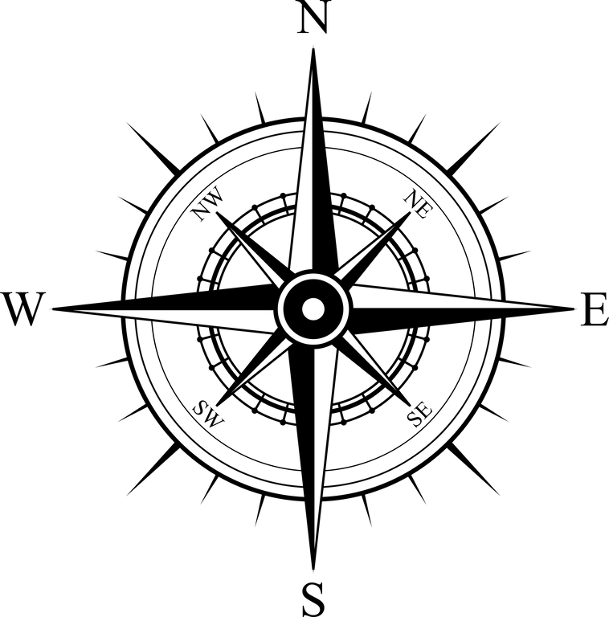

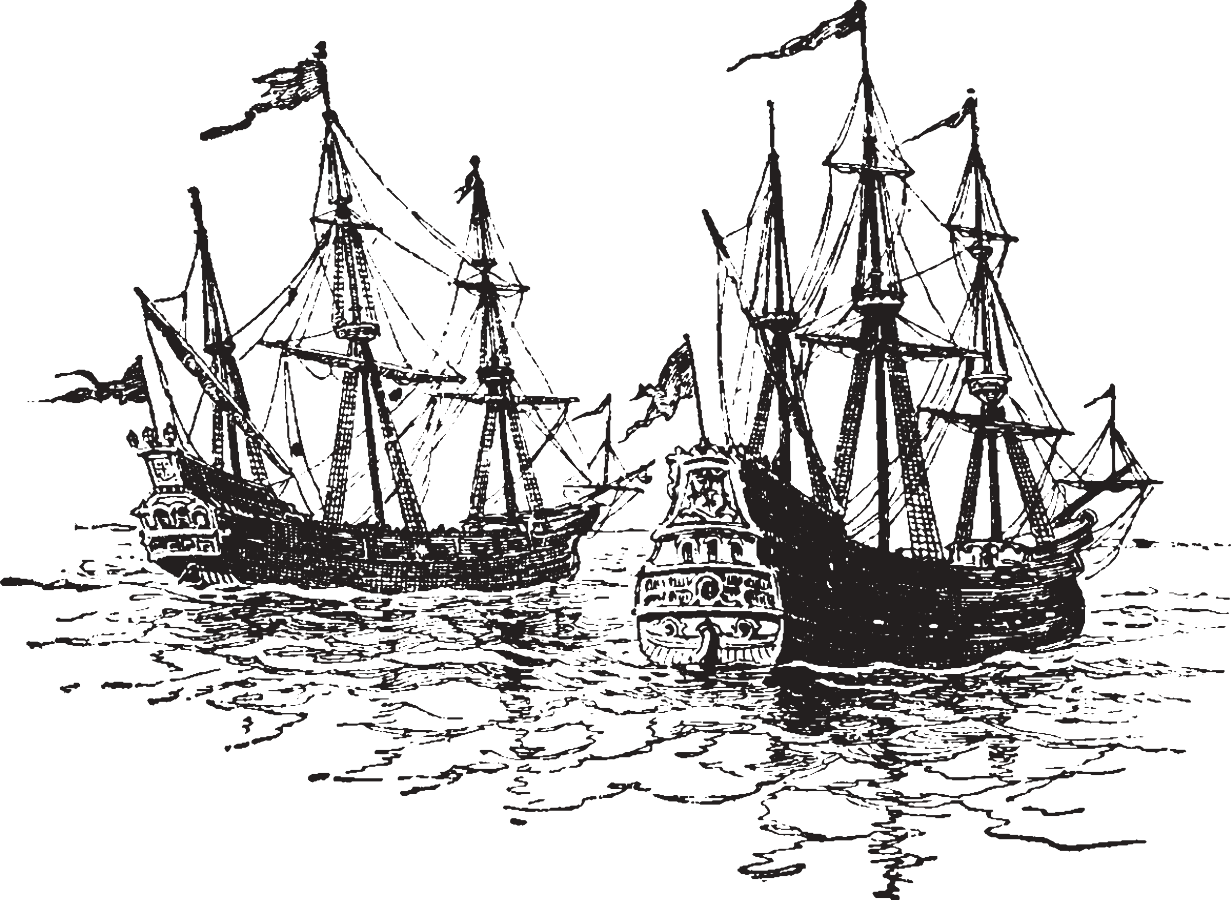
What is History?
How do historians study our past?
Aim: To understand the meaning of history and how historians study our past ?

Slide 3

Introducction
Think, Pair, Share
What is History?
Write down your definition of History.

Slide 4
D.D.Kosambi
Since we are studying Indian History we will look at historians who have done pioneering work in this field.
D.D.Kosambi was a well-known Indian polymath. Known for his achievements in Mathematics and History.
“History is the presentation in chronological order of successive changes in the means and relations of production” (Kosambi in Ancient India: A History of its Culture and Civilisation “
Add to your definition.

