Slide 1

www.tweakteach.com
©2025 TweakTeach

Slide 2
TECHNOLOGY IN NEW WARFARE
To study the technological advancements made during the First World War : Weapons of War

Slide 3
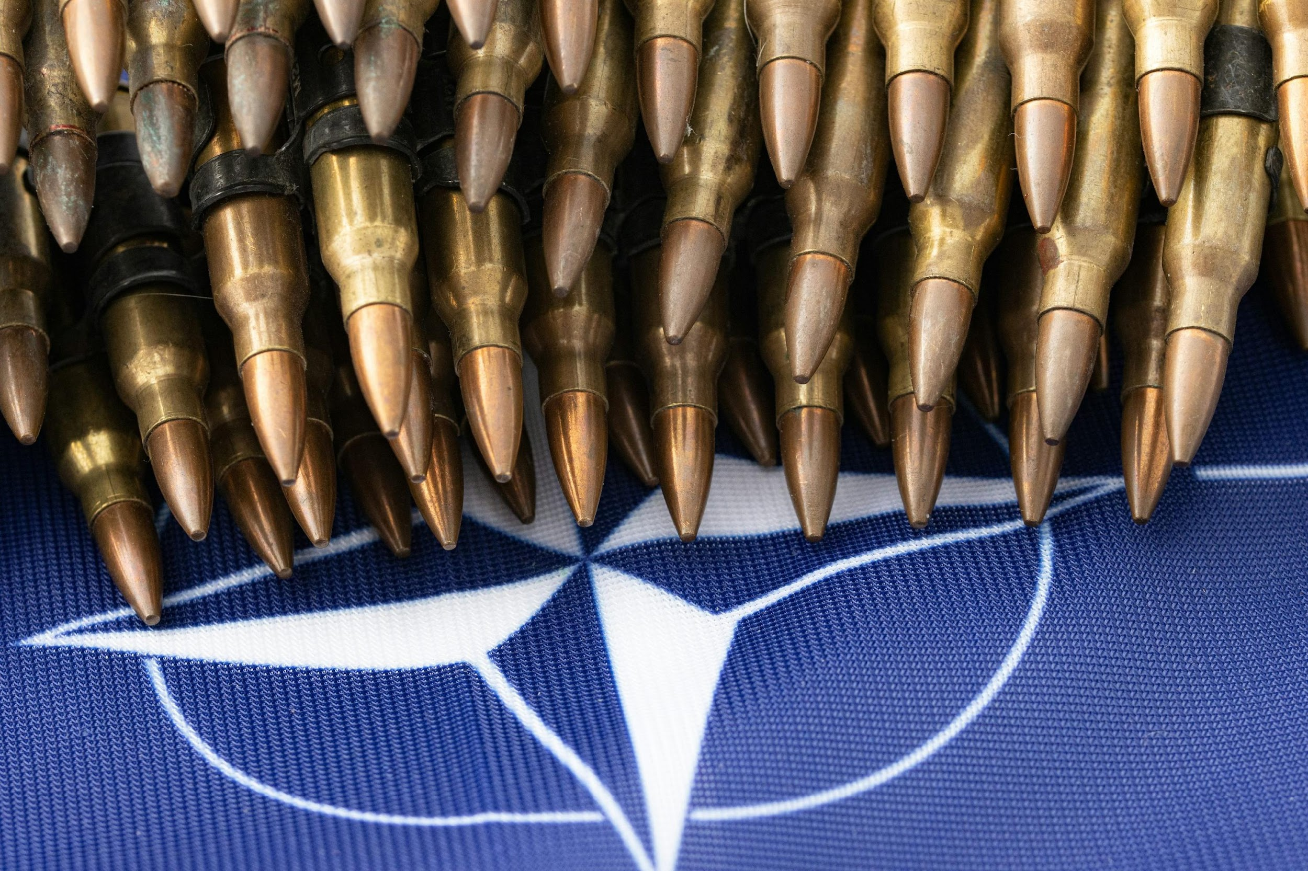
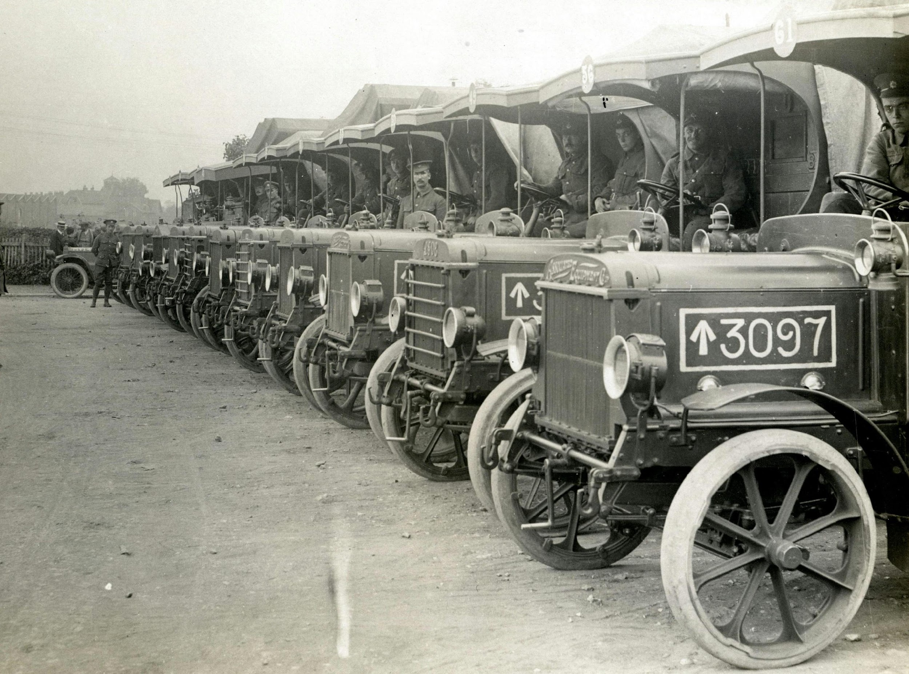
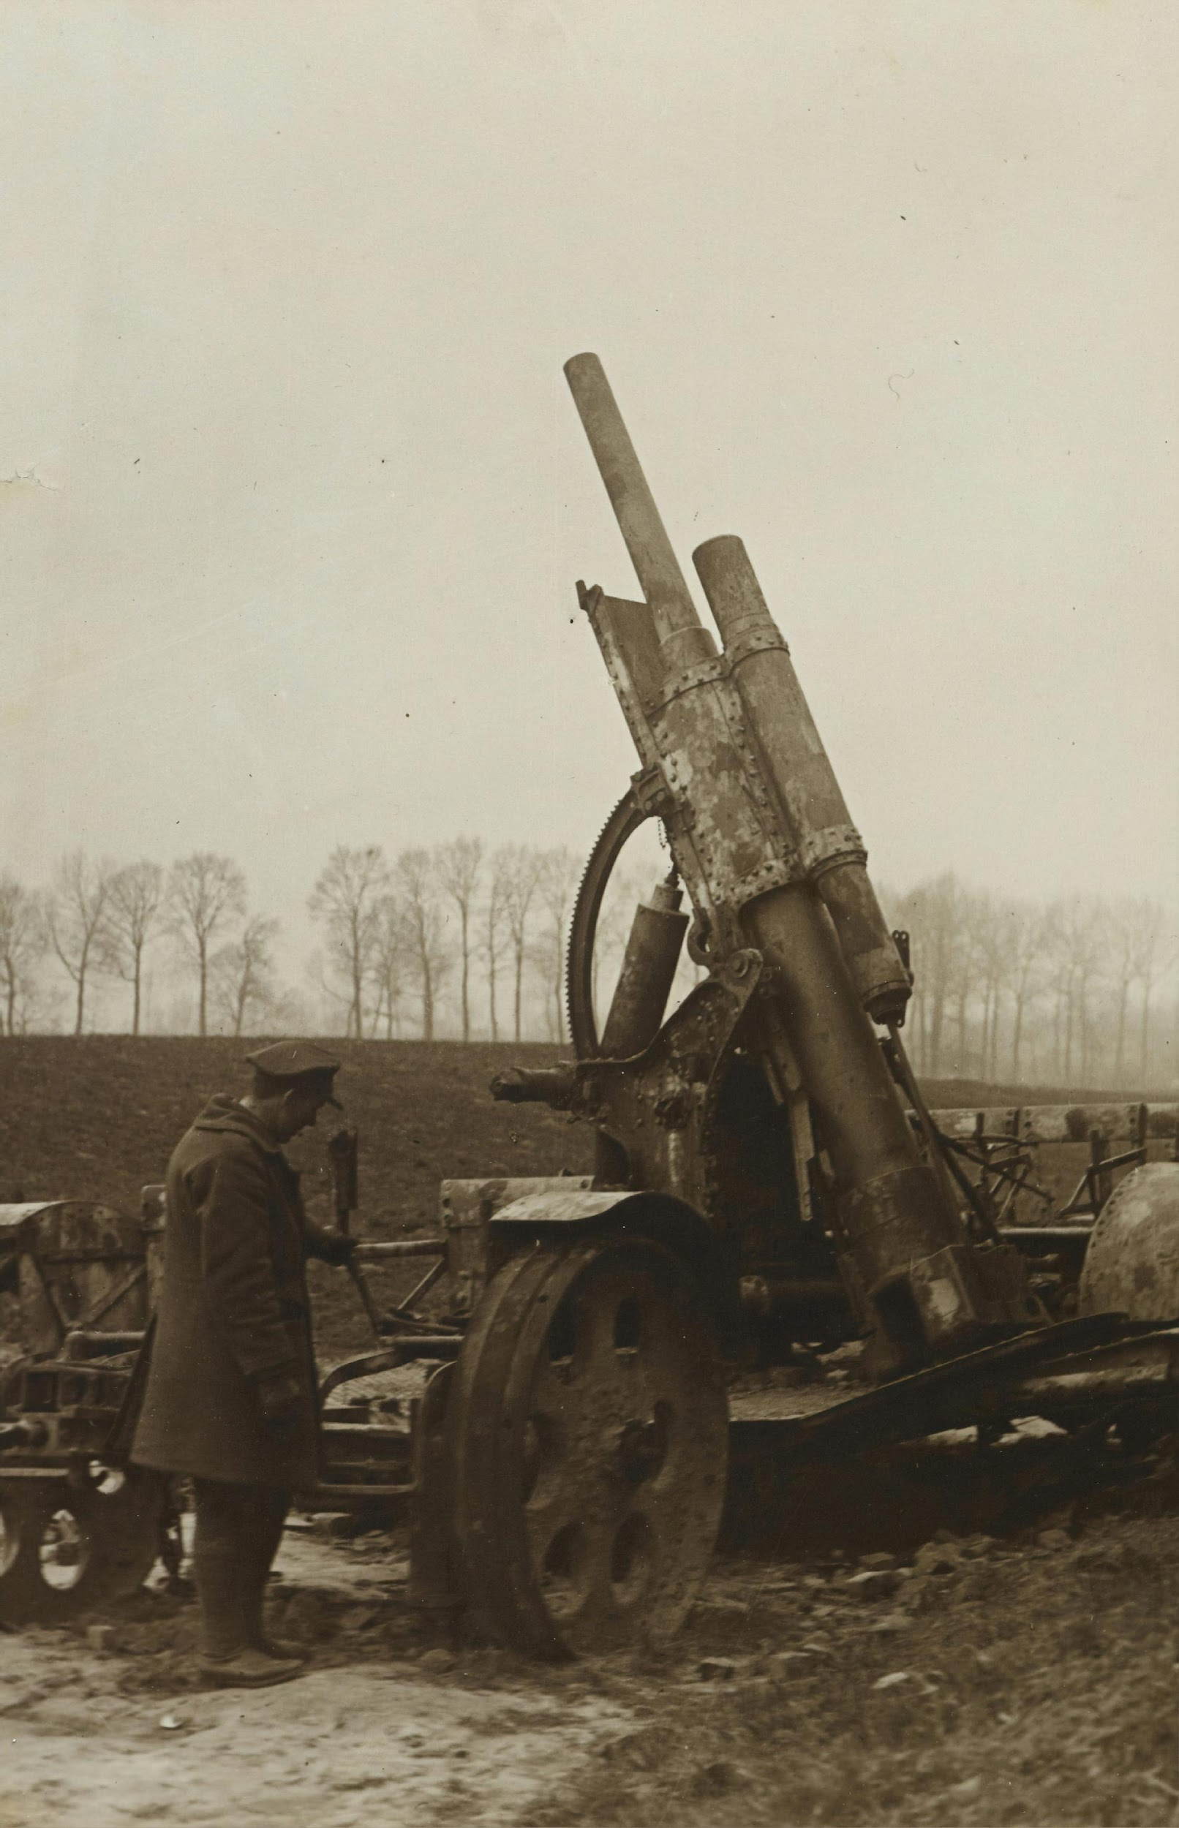
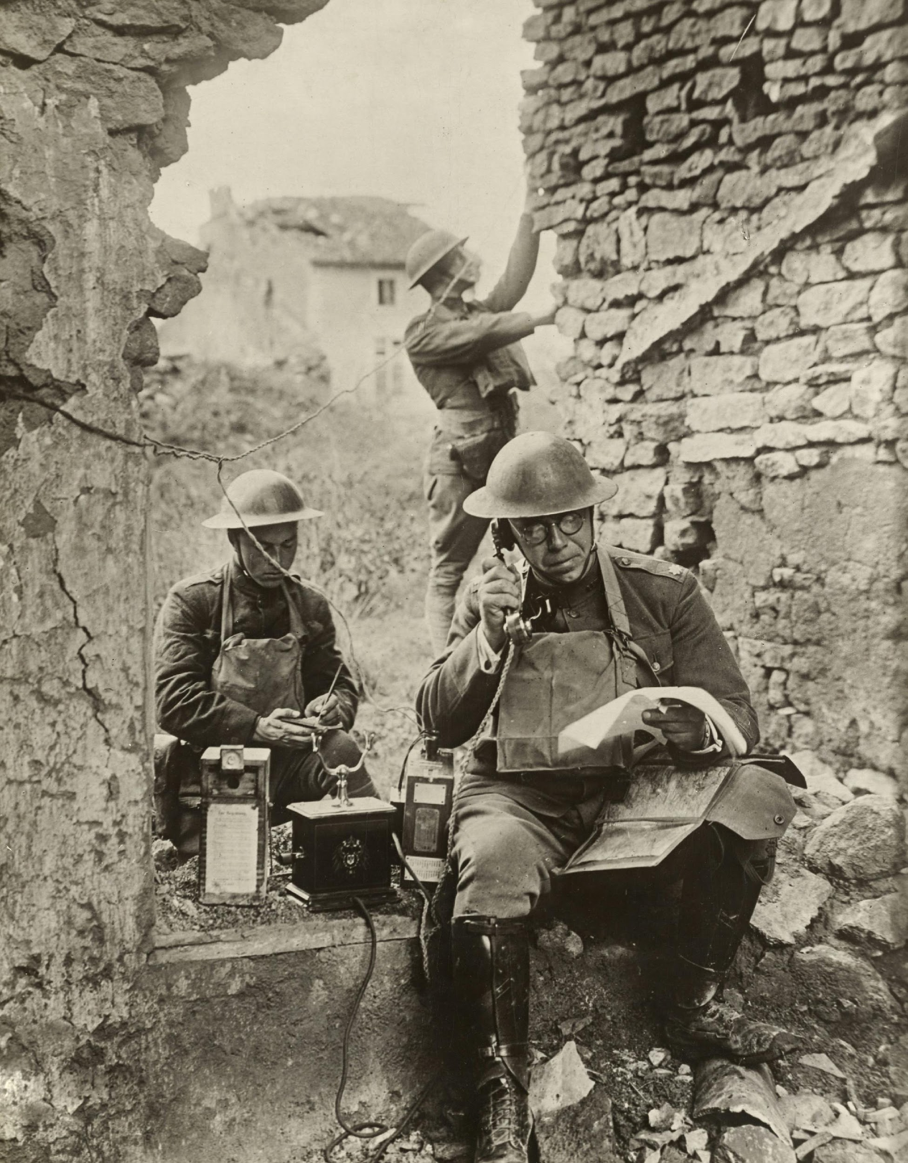
WHAT ROLE DOES TECHNOLOGY PLAY IN THE WORLD?
Let us begin with a discussion. Think and share your opinions.
What is the value of technology today?
What do you consider technology?
What role did technology play during the Great War? Do you think it changed the nature of war?

Slide 4
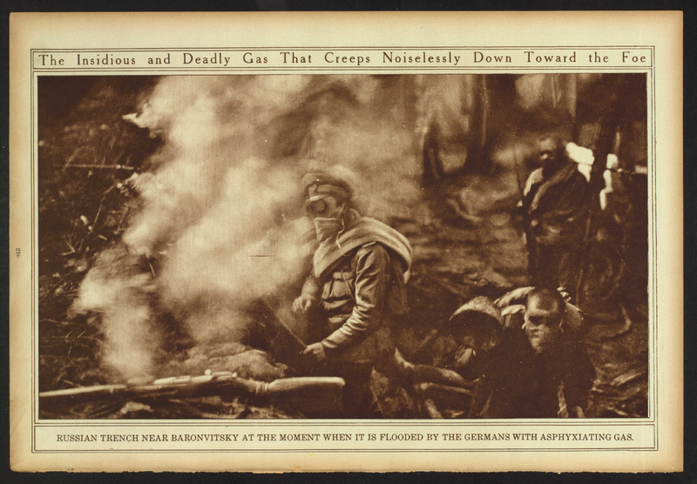
THE WAR OF CHEMISTRY
The First World War is often described as the War of Chemists because of the use of chemical weaponry
Poison gas was used as a weapon
First used by Germans on the Western Front at Ypres in April 1915
Chlorine, phosgene, and mustard gas
Gas alarms and masks were developed
Wikimedia: Russian trench at the moment when it is flooded with German gas.

