Slide 1

www.tweakteach.com
©2025 TweakTeach

Slide 2
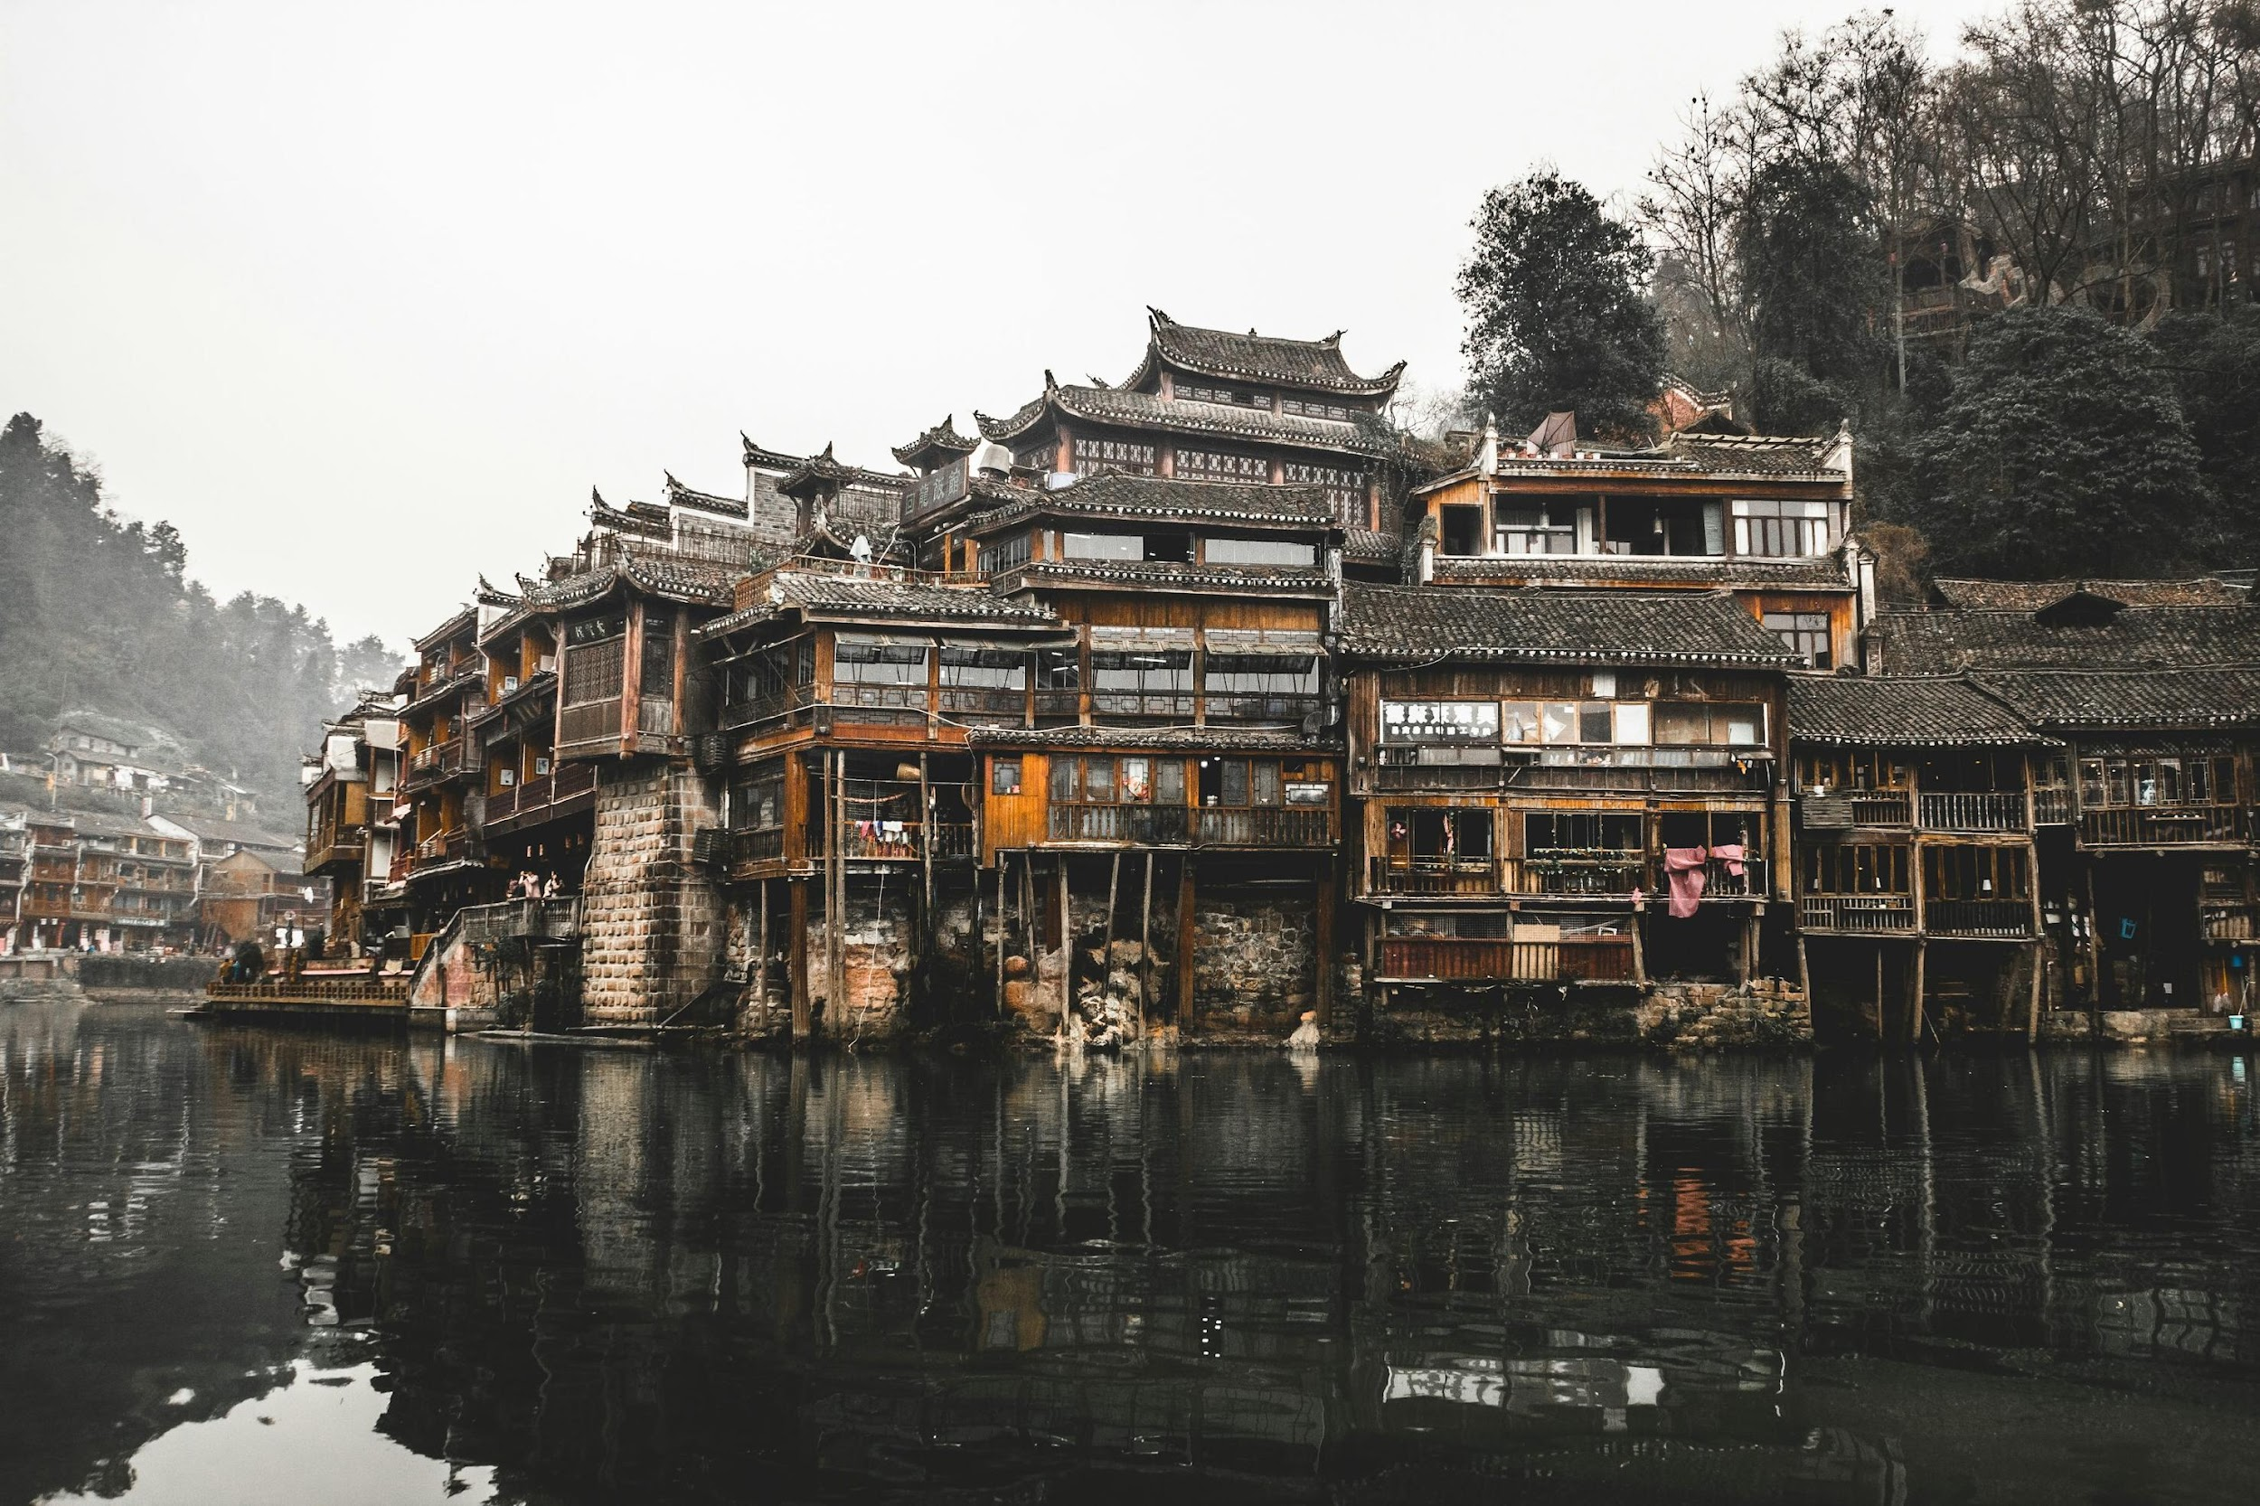
THE WARRING STATES PERIOD
To study the main features of the Warring States period
What new philosophical ideas arose during this period that could be seen as a
continuation of the previous Spring and Autumn period?

Slide 3
ANSWER THE QUESTION IN YOUR BOOKS
Dynasty Established
What led to the decline of the Warring States Period? Use the information from the next slide
Challenge – Trace the decline from the previous period, i.e, spring and autumn
Period of expansion- economic, Cultural, social, and religious
New Dynasty
Decline of the Dynasty- sudden or prolonged
Dissension, the rise of rebellion against the Dynasty

Slide 4
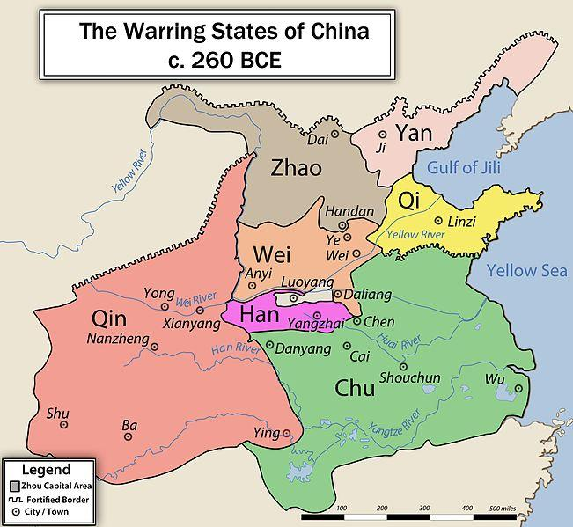
POLITICAL TURMOIL
The period was characterized by the small Kingdoms that fought against each other.
The period was marked by constant violence
The turmoil led to the separation of states after the fall of the main ruling family of Jin.
At the end of the period, the Qin states rose up and defeated the separate states and united them under one banner in 221 BCE
Spring and Autumn Period - Many peripheral states grew in power
Wikimedia: Warring States Period
Notes:
https://commons.wikimedia.org/w/index.php?search=warring+states+period+&title=Special:MediaSearch&type=image

