Slide 1

www.tweakteach.com
©2025 TweakTeach

Slide 2
THE WAR AT SEA
To understand the main events of the war at sea and their significance

Slide 3
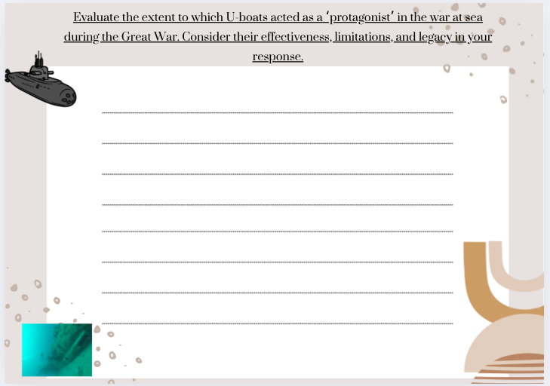
WE WILL ANSWER A QUESTION:
Evaluate the extent to which U-boats acted as a ‘protagonist’ in the war at sea during the Great War. Consider their effectiveness, limitations, and legacy in your response.
Your task is to take down notes and answer this question as a homework assignment.

Slide 4
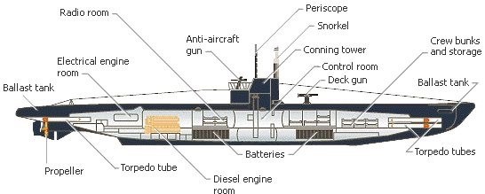
THE USE OF U-BOATS
UNDERSEA BOAT
The war at sea meant using new technology and equipment's
Submarine warfare lasted from 1915 – 18 and Germany was the first to use submarines in the war.
The U-boats, although small, could cause significant damage and did so by the end of the war.
Wikimedia : U-boat design WW1

