Slide 1

www.tweakteach.com
©2025 TweakTeach

Slide 2
FIRST WORLD WAR
SHORT-TERM CAUSES
To study the causes leading to the First World War

Slide 3
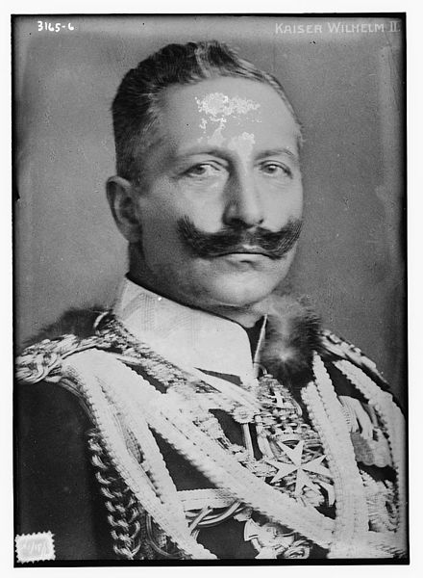
POLICIES OF KAISER WILHELM II
Born in 1861 with a bad left arm, Kaiser Wilhelm became an excellent horseman.
He was ambitious and wanted Germany to be seen as a world power
Kaiser wanted to build a powerful army
Existing debate amongst historians focuses on whether the Kaiser felt threatened by the European powers or he simply wanted Germany to be a dominant power.
Wikimedia: Kaiser Wilhelm
Notes:
Make the pupils read out loud.

Slide 4
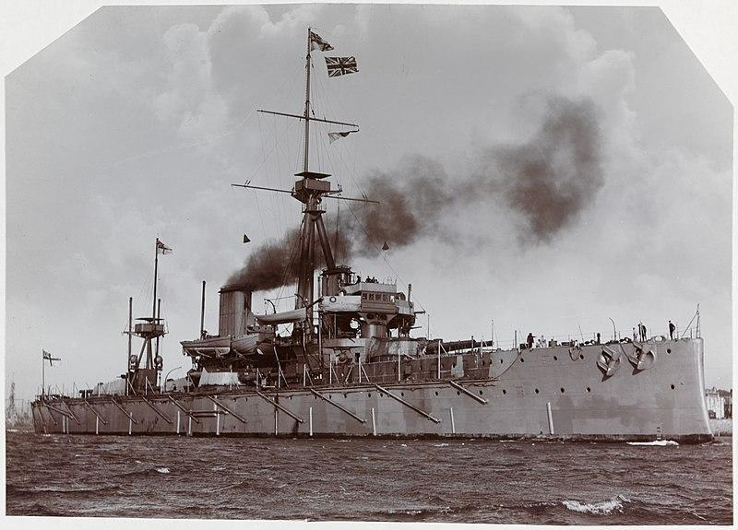
THE NAVAL RACE
Britain was threatened by Germany’s growing influence and power.
Germany’s navy was spread all over the world.
The Kaiser decided to pass the naval laws in 1898 and 1900 which intended to build battleships and cruisers.
Britain in turn launched the HMS Dreadnaught in 1906. This is based on new technology and advanced design.
The Germans launched the Rheinland
Britain replied by launching the HMS Neptune
Wikimedia: HMS Dreadnaught

