Slide 1

www.tweakteach.com
©2025 TweakTeach

Slide 2
THE IMMEDIATE CAUSE OF WW1
To understand the short-term/immediate cause of the war

Slide 3
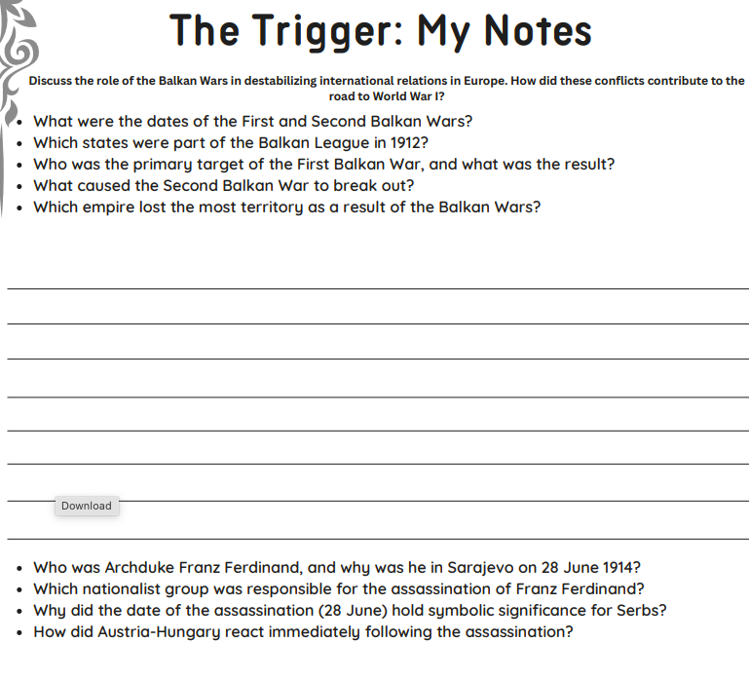
WE WILL ANSWER THIS QUESTION WITH THE HELP OF NOTES
Discuss the role of the Balkan Wars in destabilizing international relations in Europe. How did these conflicts contribute to the road to World War I?
The questions are there as a guide.

Slide 4
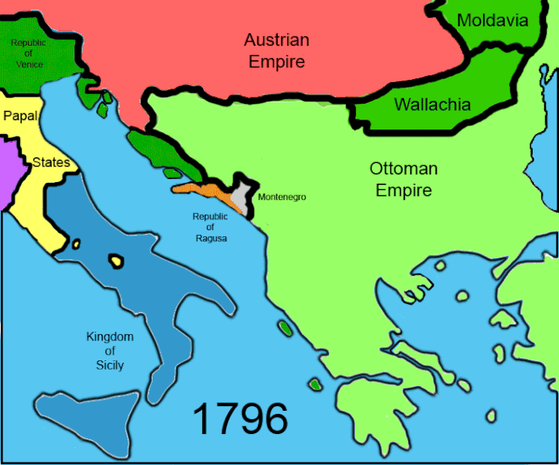
THE NEED TO CONTROL THE BALKANS
Russia, Austria-Hungary, and Germany all had an interest in controlling the Balkans. While Germany had particular economic interests, Austria-Hungary wanted to control the Serbs, and the Russians wanted to protect them.
Observe the changes in the Balkans
It was ruled by the Ottoman Empire.
What do you notice?
Get ready to share answers.
Source: Wikimedia

