Slide 1

www.tweakteach.com
©2025 TweakTeach

Slide 2
THE TRENCH LIFE
To investigate the conditions of the Trench system during the First World War

Slide 3
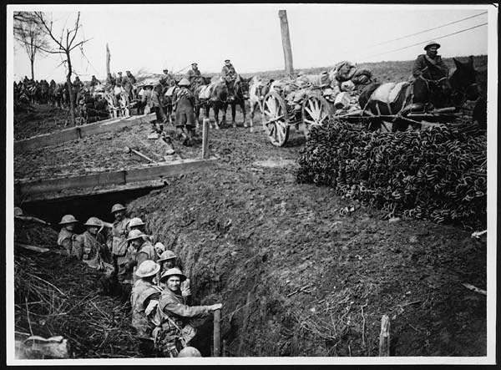
THE TRENCH
The British and French Trenches were just over 2m deep and 1.8m wide
German Trenches were often deeper
The trench system was dug in a Z-pattern - because it would make it difficult for the enemies to fire a weapon straight into the trench
Wikimedia: British Western Front in France.
The war experience of most ordinary soldiers is summed up in this image. The soldiers and their steel hats, tucked into their trench; the duckboards for access over the top; the donkeys and carriages transporting sandbags; finally the metal poles down the left side of the image were used to make the miles of barbed wire laid across no-man's-land.

Slide 4
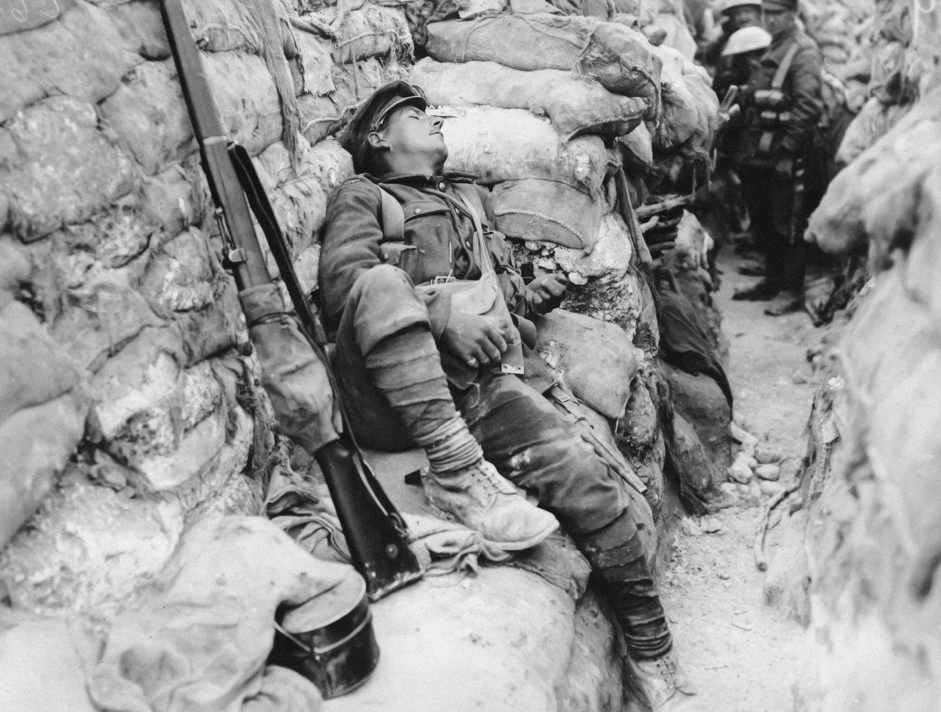
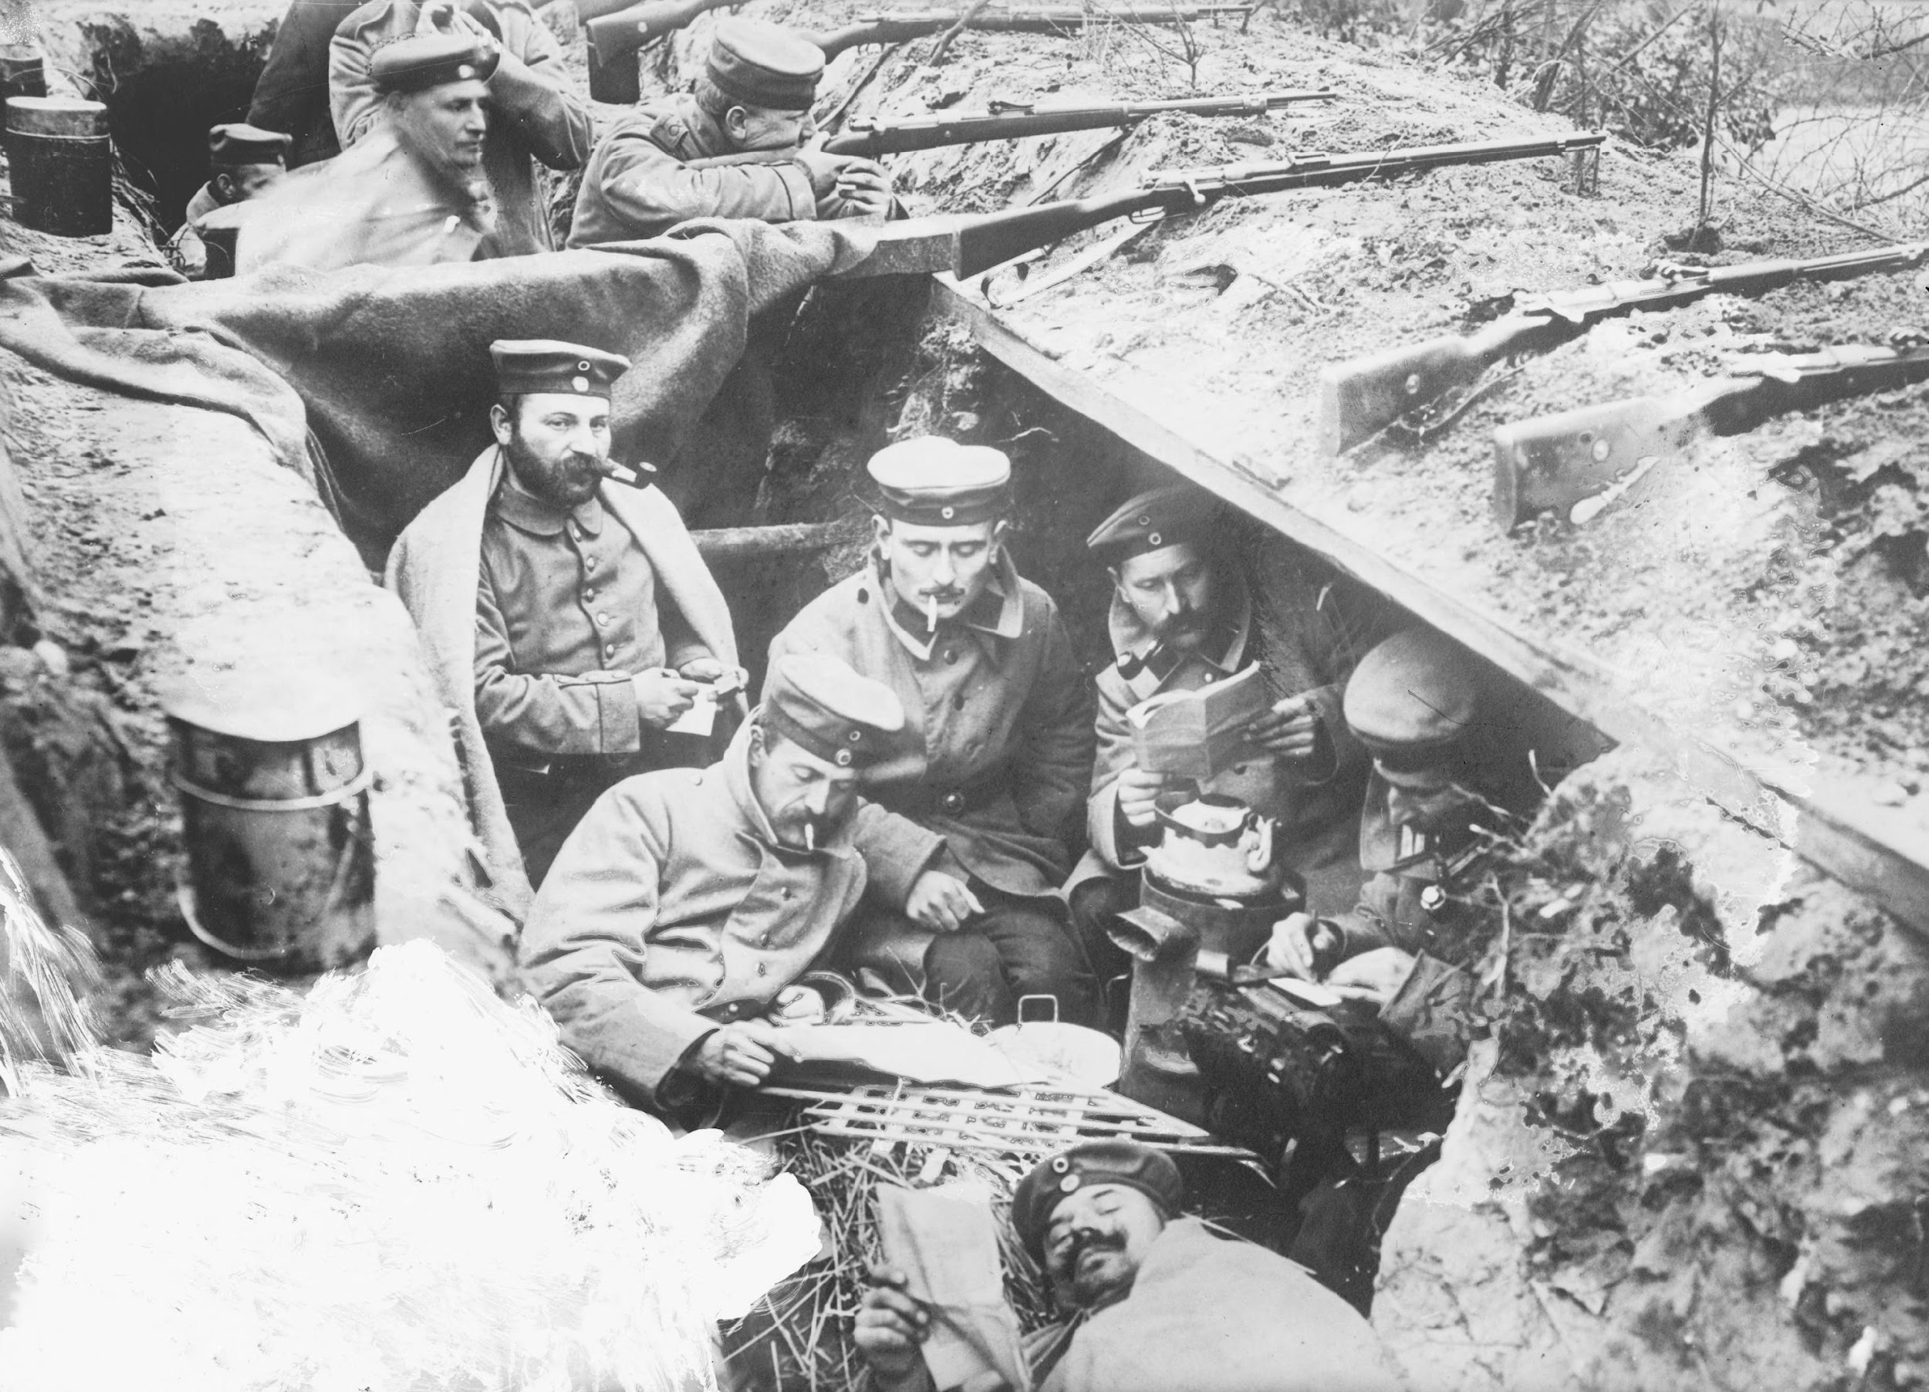
TRENCH SYSTEM
Frontline – The top of the trench was protected with sandbags to absorb the bullets. There was also barbed wire to stop the enemy.
Reserve – Supported the Frontline with medical, stables, tailors and repairers.
Communication – connected to the reserve. Soldiers would move up and down from the frontline
A French Trench
A German Trench

