Slide 1

www.tweakteach.com
©2025 TweakTeach

Slide 2
THE QING DYNASTY (1644 -1912)
To study the reasons behind the rise of the Qing Dynasty

Slide 3
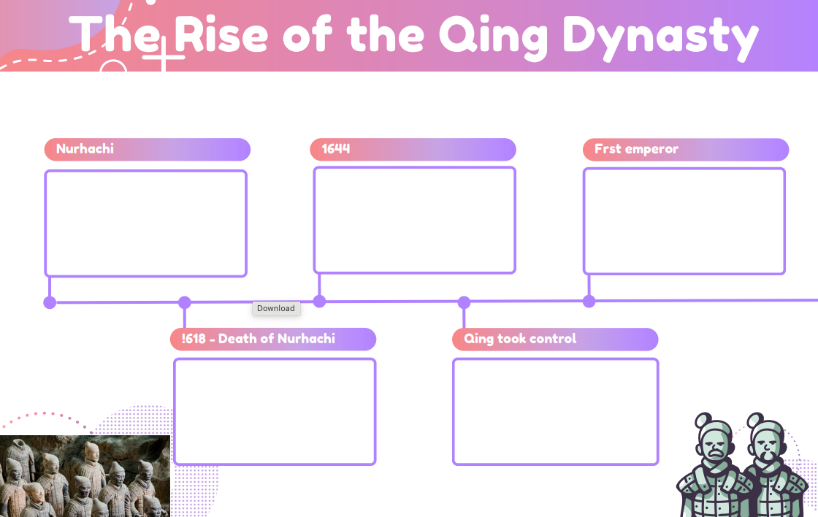
Worksheet
In this lesson, we will trace the rise of the Qing dynasty- A timeline is already drawn for you on your worksheet. You will write down the appropriate information with dates (if provided) to establish a timeline.

Slide 4


Complete your worksheet as we move through the information.
This Photo by Unknown Author is licensed under CC BY-SA

