Slide 1

www.tweakteach.com
©2025 TweakTeach

Slide 2
Fall of the Qing Dynasty
Understanding the causes behind the Fall of the Qing Dynasty
Notes:
The lesson is approximate 55 minutes but due to the nature of information it can be split into two lessons as per the speed of the teacher and the ability of the students to follow. The lesson provides a detailed understanding about the fall of the Qing dynasty but focusing on developing disciplinary knowledge associated with the second order concept of ‘cause’. The lesson is suitable for Year 7 to Year 9, however for year 9 challenges should be added to the lesson. The lesson is part of a scheme of work on China.

Slide 3

Cause I: Effects of the Opium Wars
True or False
The Opium Wars weakened the Chinese empire
Notes:
The Opium Wars would have been already completed.

Slide 4
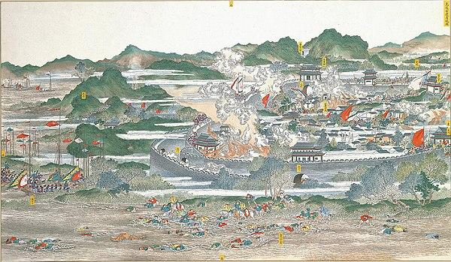
Cause II: The Taiping Rebellion
This Photo by Unknown Author is licensed under CC BY-SA
Fill in the blanks using the words in bold :
The Taiping Rebellion was led by a _______ convert named Hong Xuiquan against the _________ dynasty. The rebellion lasted for ______ years and resulted in the death of _______ soldiers and civilians. The Qing government had to take help from _________ powers to stop the rebellion. This was a civil revolt aimed at restoring the well-being of the people.
European, 20 million, Qing, 14, Christian
Notes:
Provide a printout of the gapfill.

