Slide 1

www.tweakteach.com
©2025 TweakTeach

Slide 2
Battles on the Western Front
To study the main battles and their impact on the Western Front

Slide 3
Think, Pair, Share
What do you remember about the Battle of Marne?

Slide 4
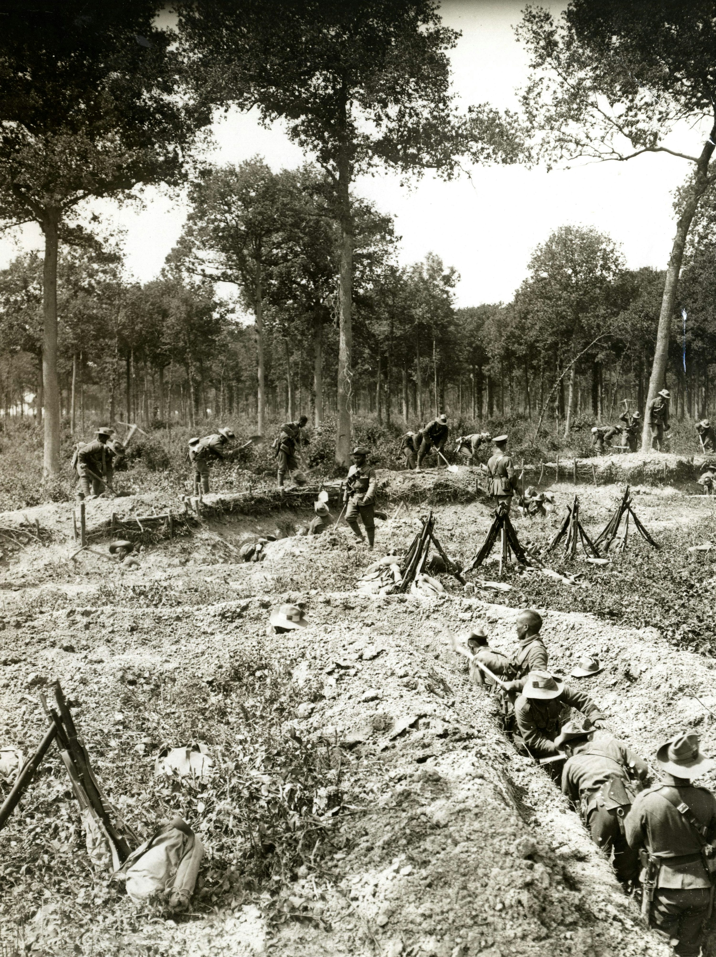
The Battle of Marne
The combined armies of France and Britain faced the Germans along the line of the River Marne in 1914
They counter attacked and pushed them back
Neither side could push the other back
Therefore, by 8th September, both sides started digging trenches to protect themselves
A deadlock was created.
World War 1. Gurkhas are working on a fire trench and a communication trench. Photographer: H. D. Girdwood.
What do we mean by a deadlock?

Slide 5
The War Continues …..

Slide 6
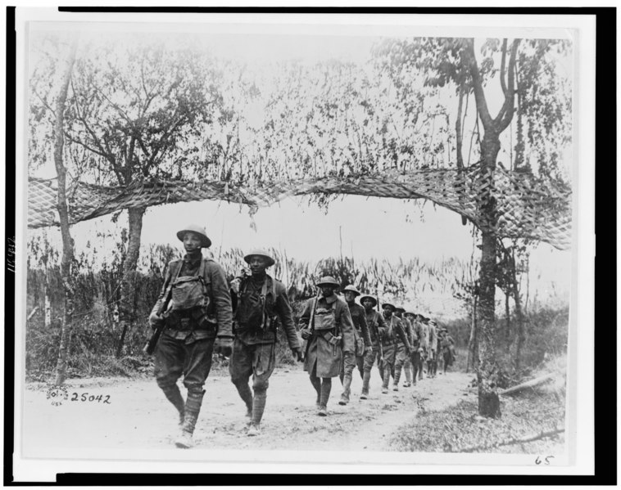
Battle at Verdun 1916
The British, French, and Germans failed to break the deadlock
In February 1916, the Germans wanted to capture important forts surrounding Verdun
The strategy of attrition – to keep testing the enemy's strength until resistance from them was not possible.
Wikimedia: U.S. Army Infantry troops, African American unit, marching northwest of Verdun, France, in World War I

