Slide 1

www.tweakteach.com
©2025 TweakTeach

Slide 2
THE SHANG DYNASTY
(1600-1046 BCE)
To study the main features of the Shang Dynasty with the help of sources.

Slide 3
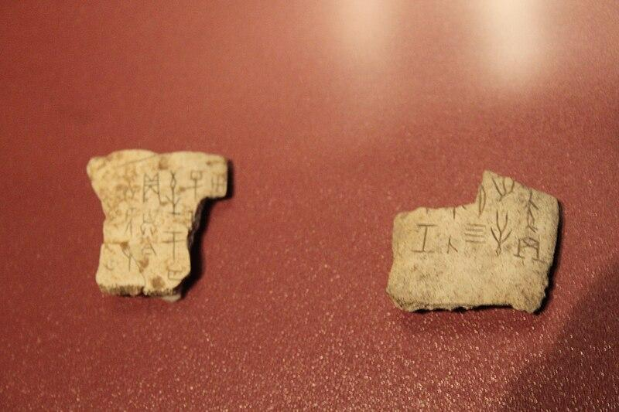
SOURCES – ORACLE BONES
The people in the Shang Dynasty believed in divination, which is a belief in the supernatural.
The people used animal bones to write questions related to divination or the future
These are now more than 3000 years old and provide us with written evidence
Keyword Alert – write down the meaning of the word in bold.
Wikimedia: Shang Oracle Ox Bone
Notes:
https://commons.wikimedia.org/wiki/File:Shang_Ox_Bone_Oracle_Bones.jpg

Slide 4
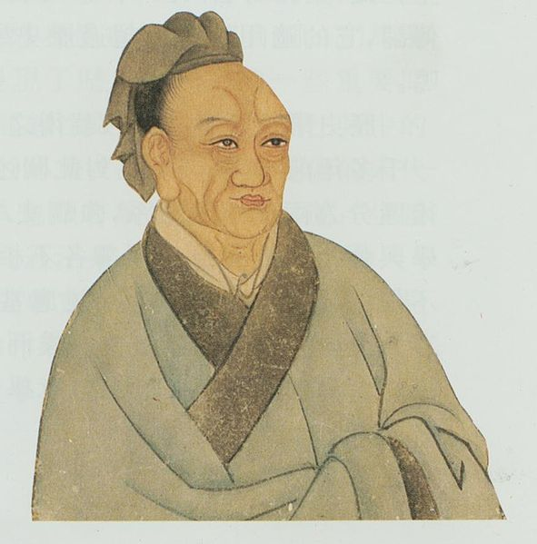
SOURCES – SIMA QIAN
Sima Qian was a Historian who belonged to the Han Dynasty
He wrote Shiji - Records of the Grand Historian
Wrote about ‘Yin’, which is another name for Shang
Wikimedia: Historian Sima Qian
Notes:
https://commons.wikimedia.org/wiki/File:Sima_Qian_(painted_portrait).jpg

