Slide 1

www.tweakteach.com
©2025 TweakTeach

Slide 2

The Second Opium War
1856-1860
What is the importance of the First Opium War in causing the Second Opium War ?

Slide 3
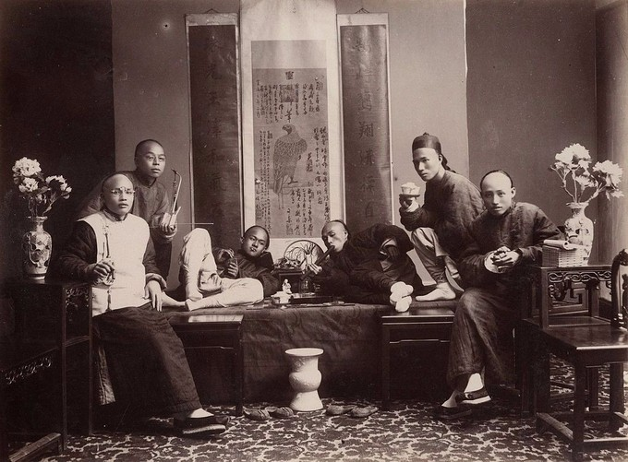

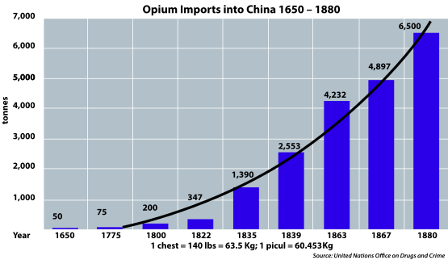
Problems in China after the First Opium War
The First Opium War showed that China was technologically weak.
China’s military faced a humiliating loss
More and more opium was imported
Foreign influence in trade increased, and more goods came into the country
This Photo by Unknown Author is licensed under CC BY-SA
This Photo by Unknown Author is licensed under CC BY-SA

Slide 4
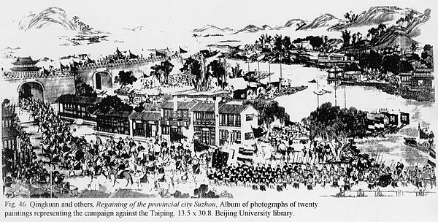
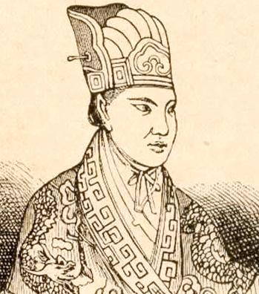
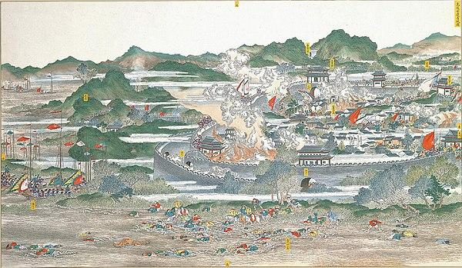
The Taiping Rebellion (1850 -1864)
This Photo by Unknown Author is licensed under CC BY-SA
The rebellion lasted for 14 years, and the leader was a Christian convert.
The rebellion led to the demise of 20 million soldiers.
The rebellion aimed to convert people to Christianity, end practices such as enslaving people, the smoking of opium, and foot binding.
It was crushed in 1864 with the help of foreign forces.
This Photo by Unknown Author is licensed under CC BY-SA
How would this affect the position of China against Britain?
This Photo by Unknown Author is licensed under CC BY-SA

