Slide 1

www.tweakteach.com
©2025 TweakTeach

Slide 2
Qing China
To understand the life of the people in Qing China, focusing on the status of women.

Slide 3
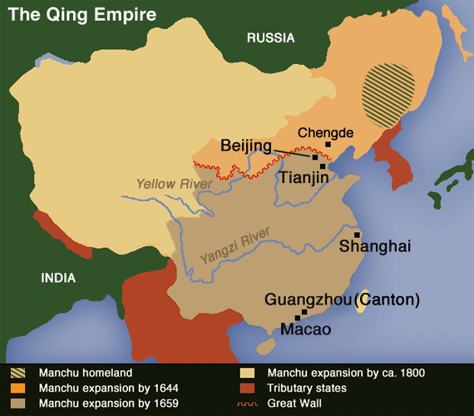
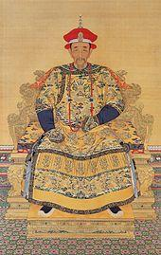
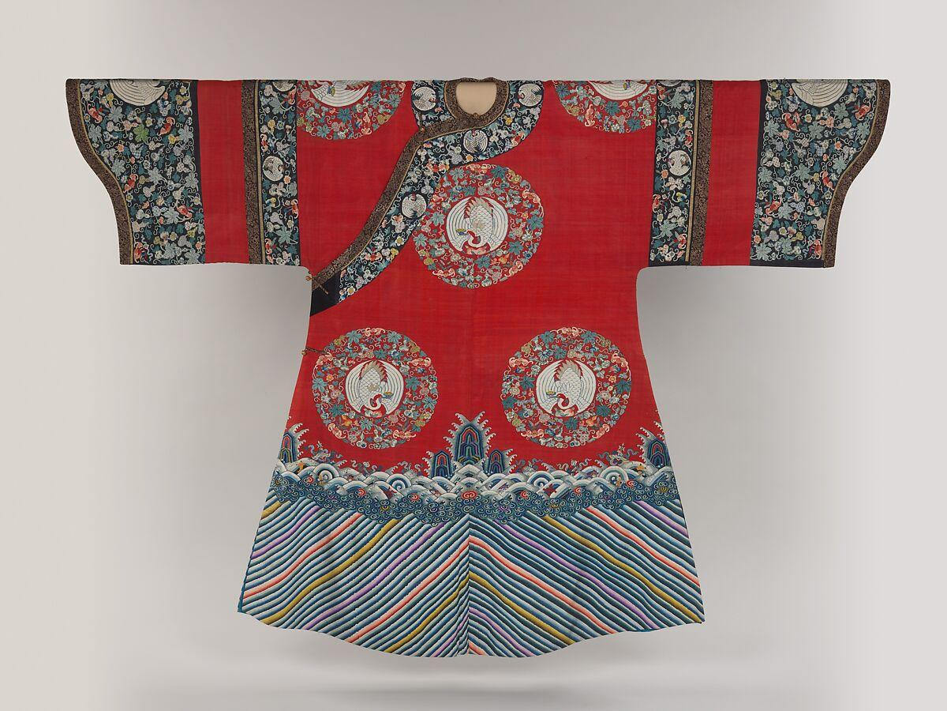
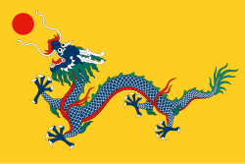
The largest empire in the world
The Qing Dynasty in the eighteenth century became the largest and most prosperous empire in the world. Three emperors made the Kingdom prosperous: Kangxi, Yongzheng, and Qianlong.
This Photo by Unknown Author is licensed under CC BY-SA
This Photo by Unknown Author is licensed under CC BY-SA
This Photo by Unknown Author is licensed under CC BY-SA-NC

