Slide 1

www.tweakteach.com
©2025 TweakTeach

Slide 2
THE RISE AND FALL OF THE QIN DYNASTY (221 -206 BCE) THE FIRST IMPERIAL DYNASTY
TO UNDERSTAND WHETHER THE QIN STATE WAS A STATE OF REFORM OR REPRESSION

Slide 3
DYNASTIES
Dynasty | Date
Xia | 2070 BCE – 1600 BCE
Shang | 1600 – 1046 BCE
Chou/Zhou | 1046 – 256 BCE
Qin | 221 BCE – 207 BCE
Han | 206 - 220 CE
Tang | 618 – 906 CE
Song | 960 – 1279 CE
Ming | 1368 - 1644
The History of China can be studied by looking at the various Dynasties

Slide 4
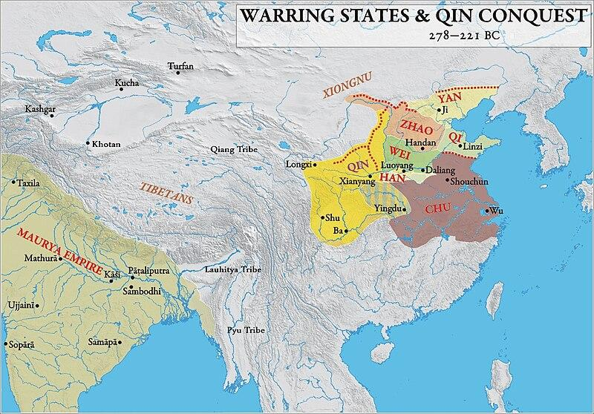
HOW DID THE QIN COME TO POWER?
The Qin adapted to the ways of life that were incepted by the Zhou. In the spring and autumn periods, they concentrated on making diplomatic relations with the states. However, this changed in the warring states period, where they won battles and overthrew the Zhou with their military power.
Wikimedia : Qin Conquest

