Slide 1

www.tweakteach.com
©2025 TweakTeach

Slide 2



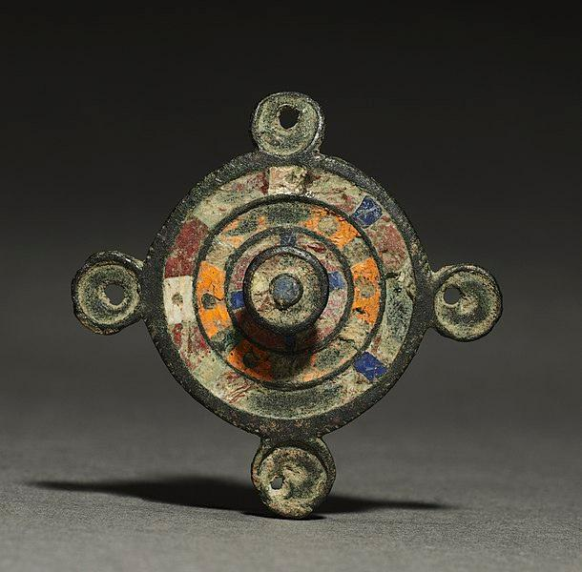

Prehistoric England
To understand the main features of prehistoric England and the arrival of the First people

Slide 3




The earliest known Humans arrived around 900,000 years ago.
  Prehistory in England lasted until 43 CE/AD
  Archeologists, like investigators, have studied the various artefacts, hillforts, and even burial sites. These sources give us a picture of the way people lived during that time.
What kind of primary sources will historians use to study prehistory? Remember, written sources were not abalaible.
Notes:
https://www.english-heritage.org.uk/learn/story-of-england/prehistory/
2

Slide 4



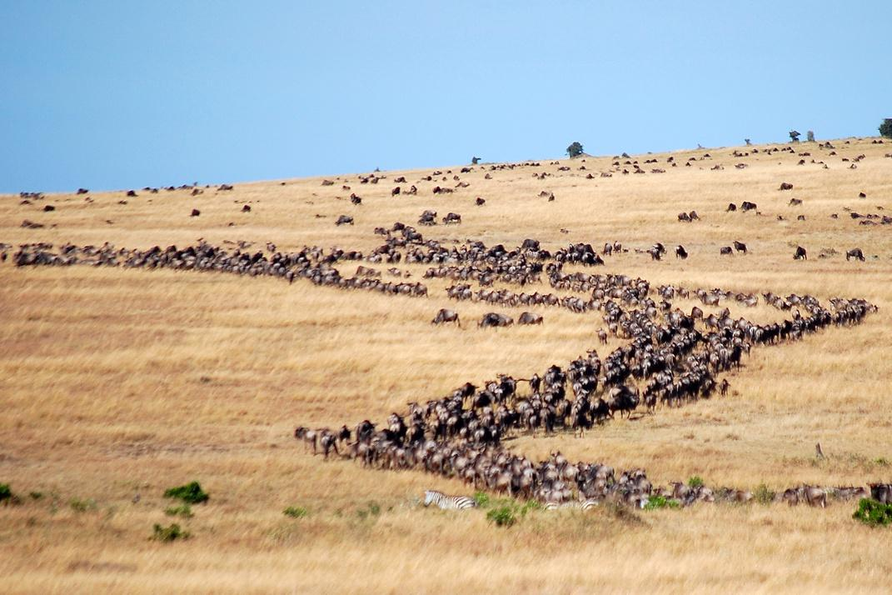
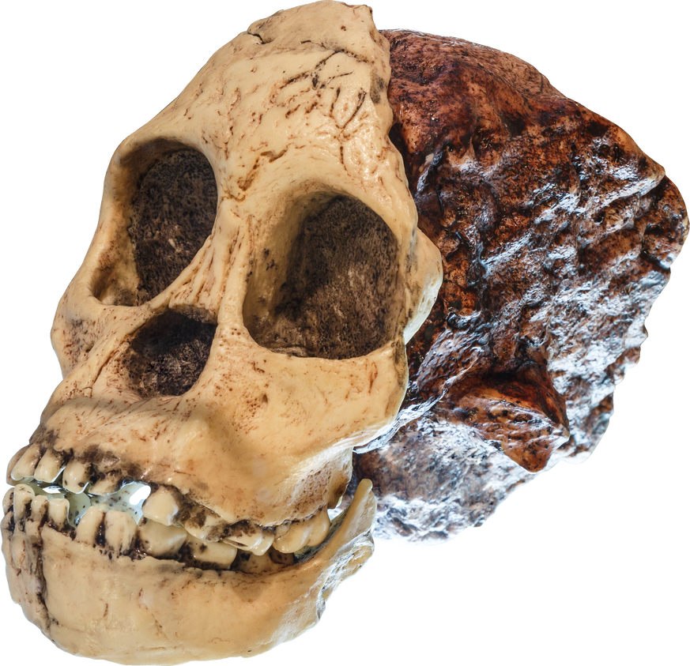
Migration to England
People from continental Europe started migrating to Britain and settling down around 12000 years ago.
After this, many new communities have migrated and settled down.

