Slide 1

www.tweakteach.com
©2025 TweakTeach

Slide 2
THE WAR CONTINUES
To study the impact and consequences of the Battles on other fronts

Slide 3
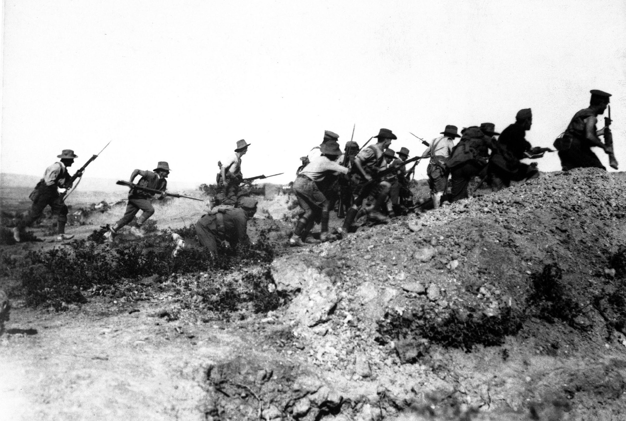
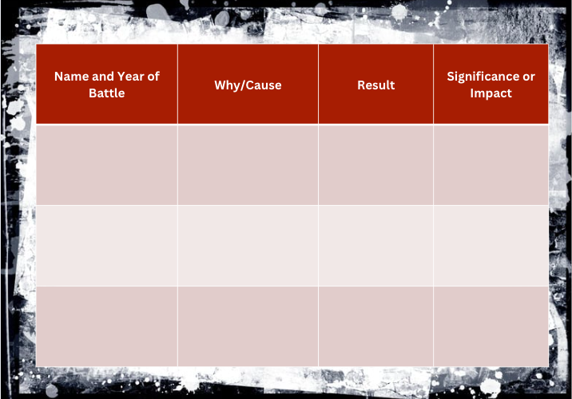
EASTERN FRONT - WAR AT GALLIPOLI
The stalemate on the Western Front would continue. Therefore, Winston Churchill planned an attack on the Dardanelles Strait, which gave access to the Black Sea
The attack on Ottomans
The battle, if successful, would help Russia acquire supplies
Australian WWI troops charging near a Turkish trench. When they got there, the Turks had retreated. Dardanelles Campaign, WWI. 1915.

Slide 4
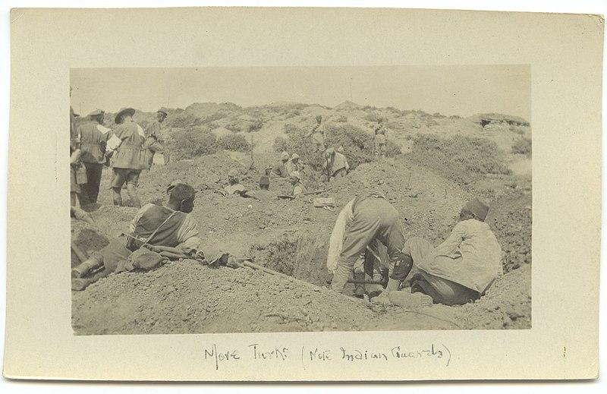
FAILURE: MARCH - APRIL 1915
The attack began in March and was mainly at sea in the beginning
When the warships could not take the shell fire from the forts, the attack transferred to land
There were attacks made by the Allied forces (British and ANZAC; Australian and New Zealand) on the Helles Beach and Suvla Bay
The Ottoman forces were strong, and the British and ANZAC forces could not penetrate
The heat and the decaying bodies made it difficult
Wikimedia: Prisoners of War

