Slide 1

www.tweakteach.com
©2025 TweakTeach

Slide 2
WORLD WAR I
THE MOROCCAN CRISIS
To understand the significance of the Moroccan Crisis

Slide 3
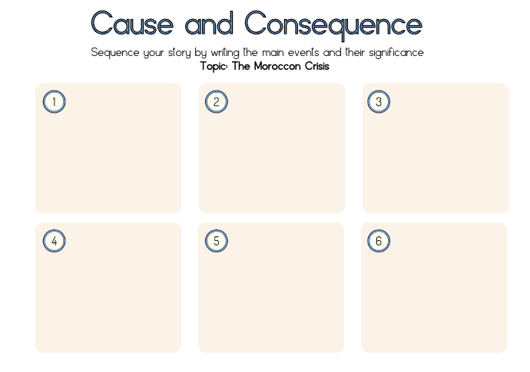
Internal Politics in Morocco
In the early twentieth century, Morocco was not under European rule
The country faced a number of problems. Morocco was ruled by Sultan Abdul Aziz, and he had really lost control.
The Berber tribes who lived in the Atlas mountains have origins that are shrouded in mystery.
By 1903, the rebels had entered the capital city, and the people supported their effort.
The Berbers wanted independence
Notes:
https://dunesdeserts.com/en/in-the-footsteps-of-the-berber-people/#:~:text=Among%20the%20most%20well%2Dknown,the%20Tuaregs%20in%20the%20Sahara.

