Slide 1

www.tweakteach.com
©2025 TweakTeach

Slide 2
HOW DID MIGRATIONS SHAPE BRITISH SOCIETY ?
To study the migration of Celts, Romans, Anglo Saxons and the Vikings and how this changed Britain?

Slide 3
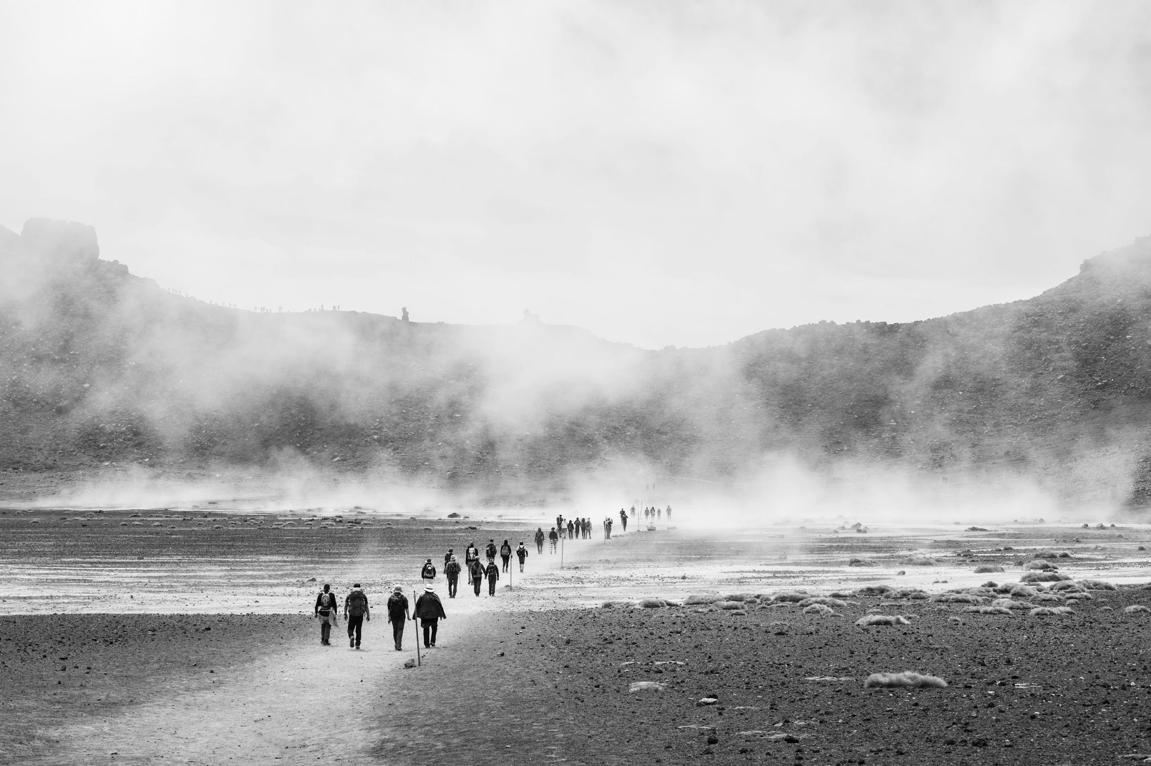
WHAT IS THE MEANING OF MIGRATION?
The movement from one place to the other
This could be within the country or across borders
Explain to me your definition of migration? Do you think ‘migration’ is good or bad?
Notes:
It would be beneficial to start a discussion on this topic. Children should be able to listen and understand both sides of the argument.

Slide 4
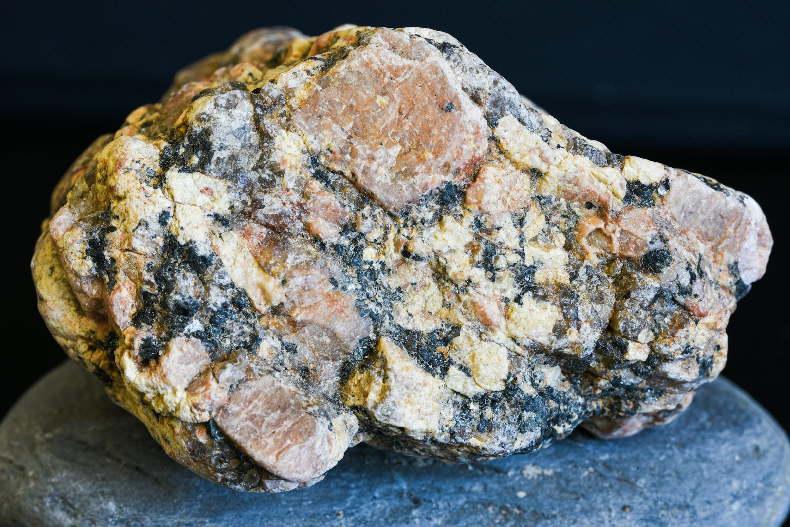
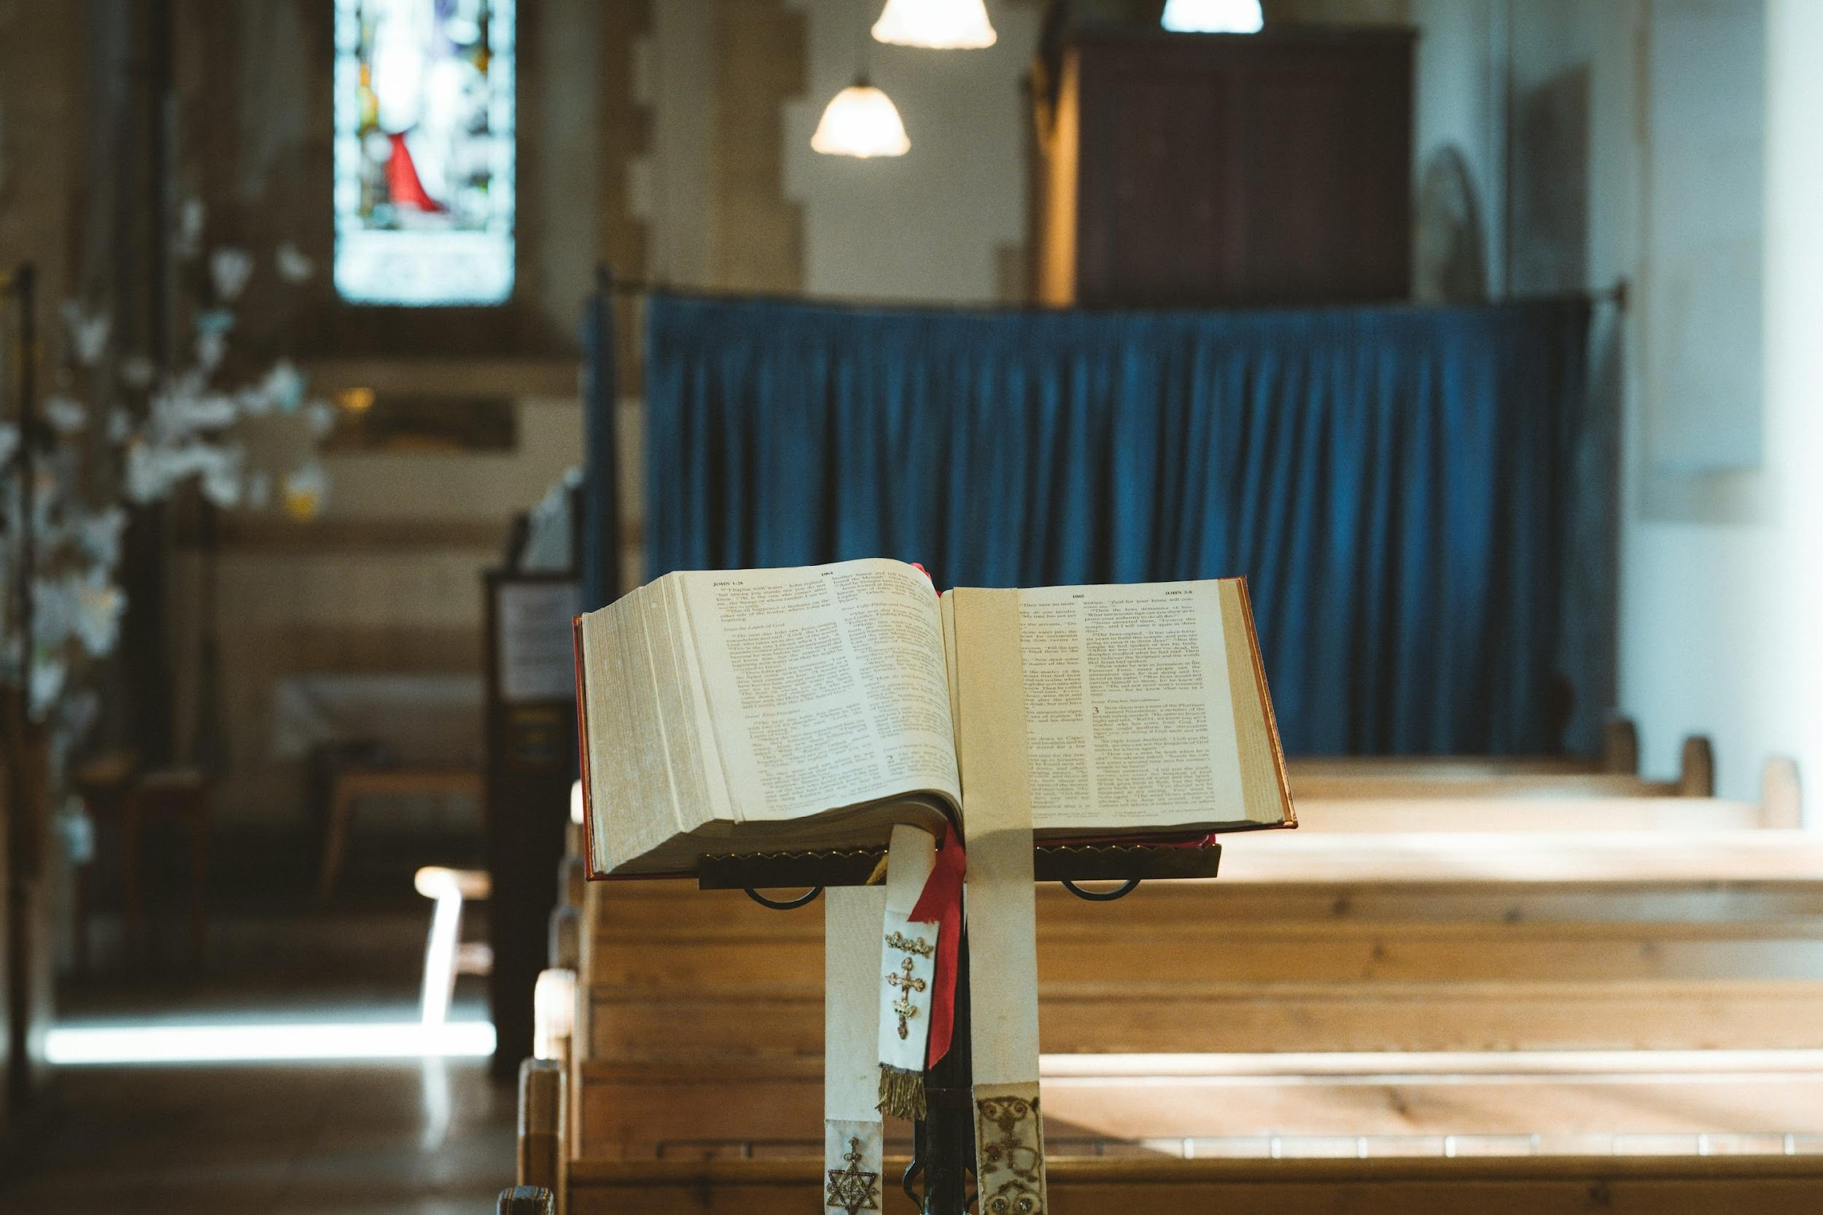
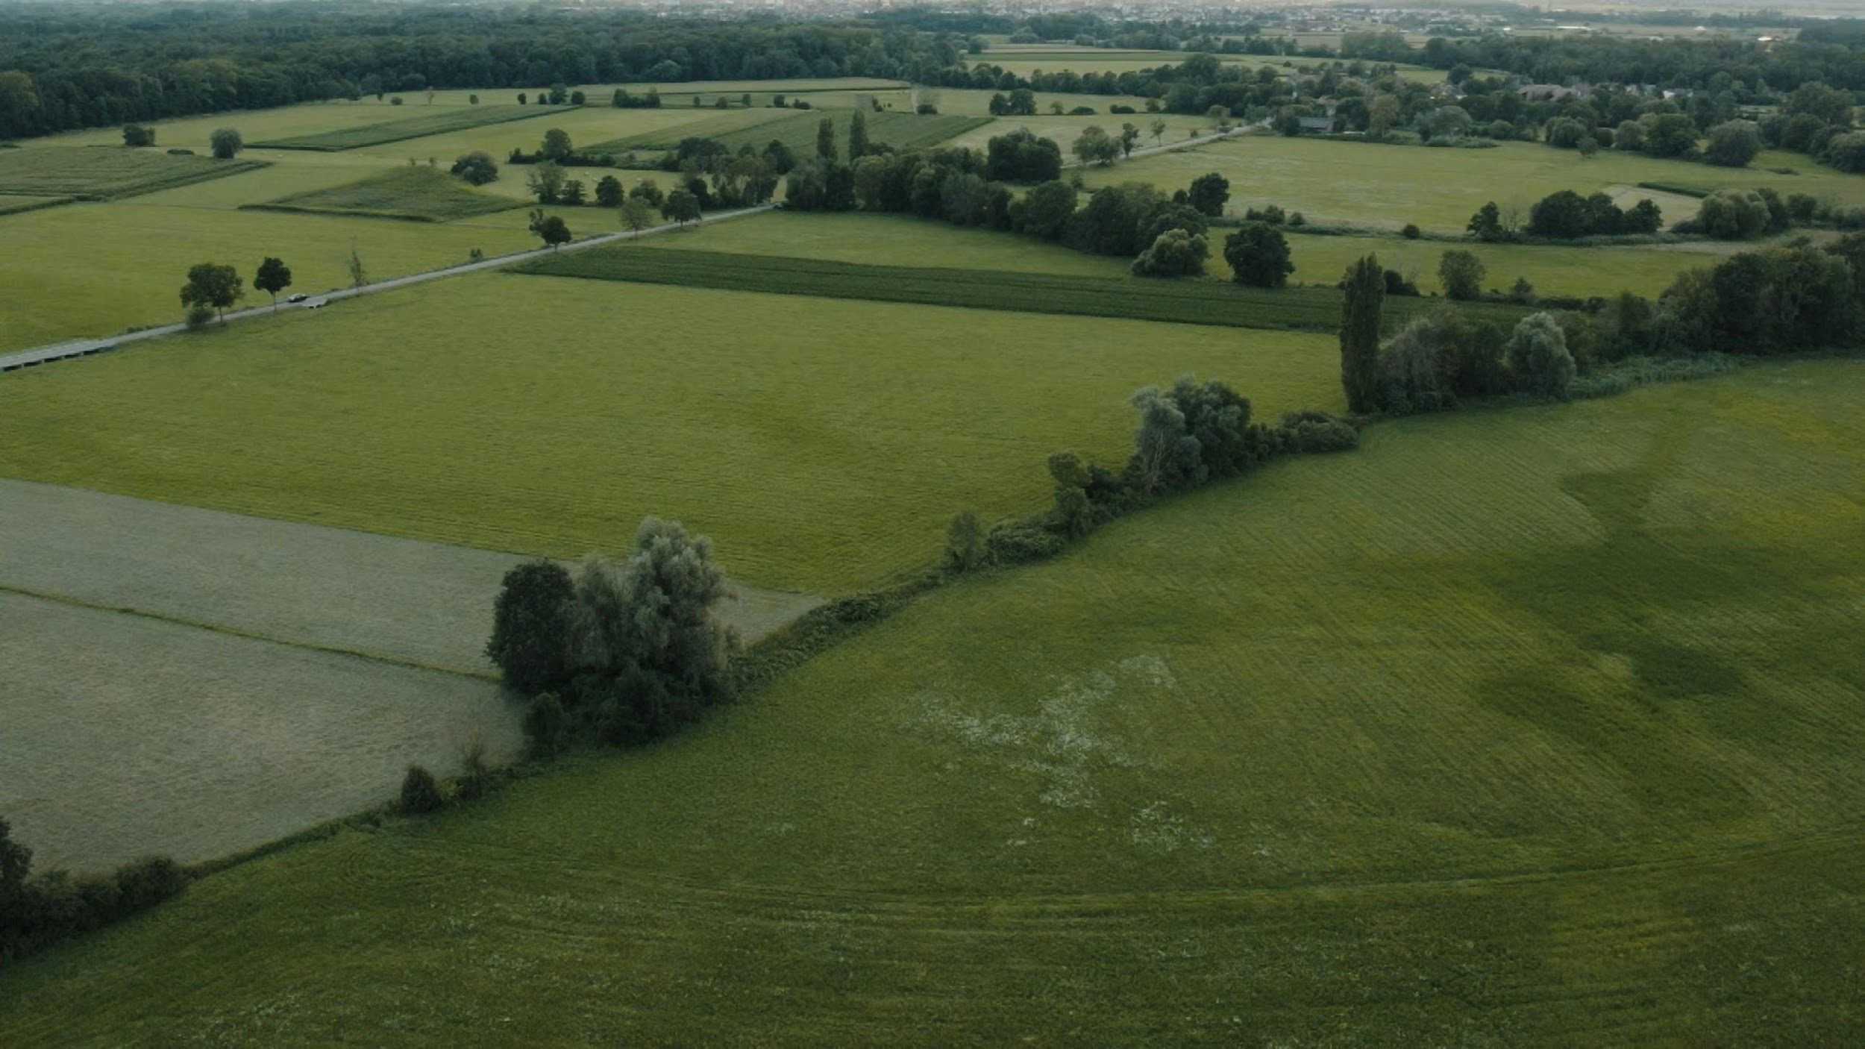
WHY DID PEOPLE WANT TO MIGRATE TO BRITAIN?
Britain had fertile land
Britain also had minerals
People migrated to Britain for religious reasons

