Slide 1

www.tweakteach.com
©2025 TweakTeach

Slide 2
THE FIRST WORLD WAR
(1914 – 1918)
To study the events that led to the First World War and to answer ‘The Alliance System was the main cause of the First World War.’ How far do you agree with this statement? Explain your answer.

Slide 3
WHAT ARE THE CAUSES BEHIND THE FIRST WORLD WAR?
Think, Pair, Share, and I will put it up on the board.
What is the difference between short term and long term causes?

Slide 4
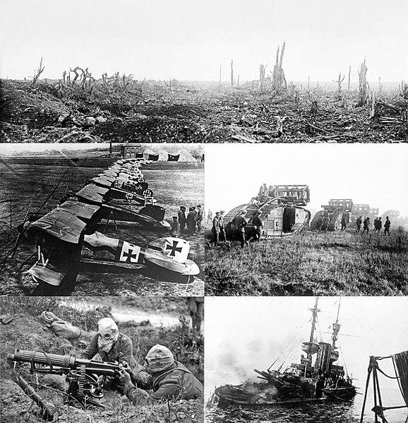
THE BACKGROUND
The years before the first world war, there existed tensions coupled with fear and suspicion between European countries.
Two groups formed that eventually would fight against each other in the Great War.
Wikimedia – WWI Trenches

