Slide 1

www.tweakteach.com
©2025 TweakTeach

Slide 2
LIFE OF THE INDO-ARYAN PEOPLE (1500-500BCE)
What can the sources tell us about the life of the Indo-Aryan people?

Slide 3
WE WILL STUDY THE CHANGES IN THE VEDIC AGE
Focus is on two periods :
Early Vedic Age (1500 BCE – 1000 BCE) – Source: Rigveda
Later Vedic Age (1000 BCE - 600 BCE) – Source: All four Vedas
You will use the worksheet to note the changes that occur in the society.
Name | These are tentative dates
Rigveda | 1500–1200 BCE
Yajurveda | 1200–800 BCE
Samaveda | 1200–900 BCE
Atharvaveda | 1000–800 BCE

Slide 4
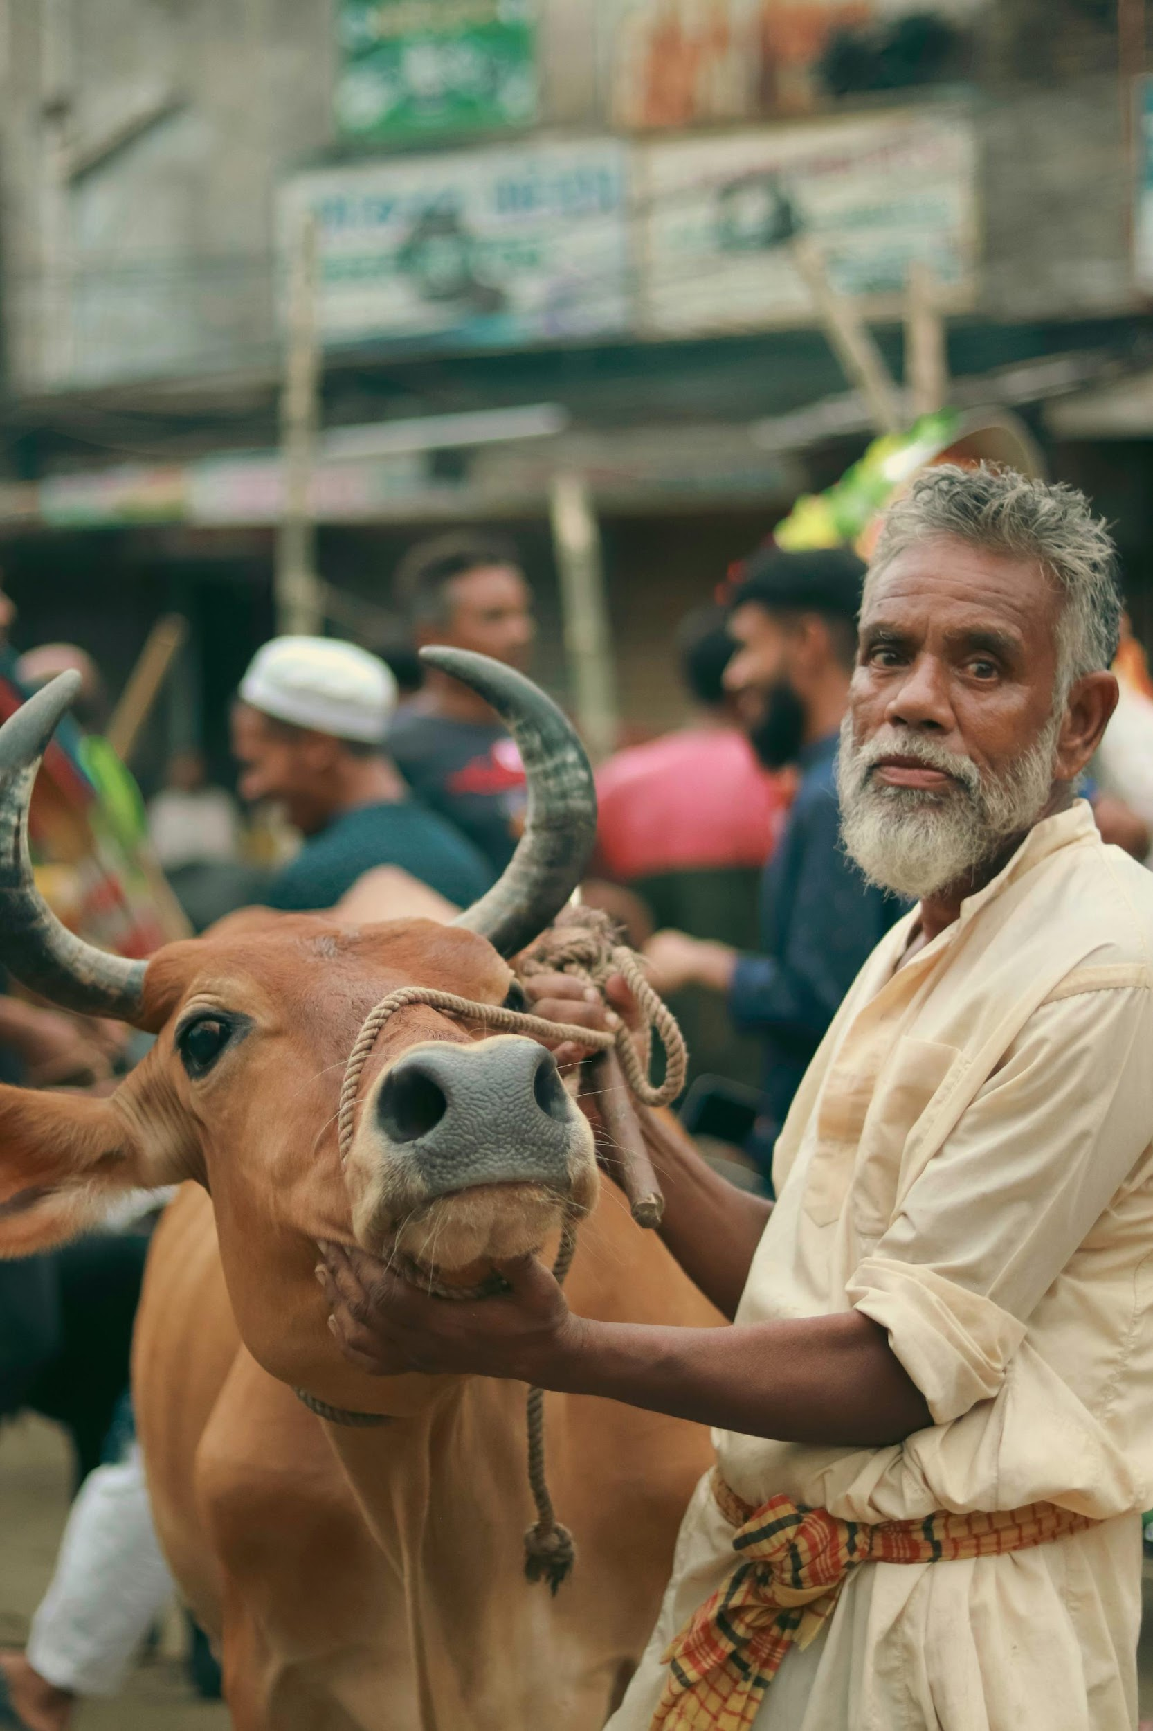
RIGVEDA AS A SOURCE: ECONOMY
Cattle was important – Cattle raids took place (R.S. Sharma 1983)
The measurement of wealth would be considered by ownership of cattle. The owner of cattle was known as a ‘GOMAT’
A group of historians argue that agriculture was only practiced by non-Indo-Aryans

