Slide 1
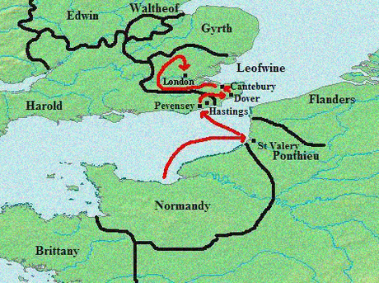
WHAT KIND OF RESISTANCE DID WILLIAM FACE ONCE HE WAS CROWNED KING?
To discuss the different ways William of Norway faced resistance from the Anglo-Saxons and the outcomes of William’s actions.

Slide 2


CHECK PREVIOUS KNOWLEDGE
What happened in 1066?
Battle of Hastings
Battle of Stamford Bridge

Slide 3
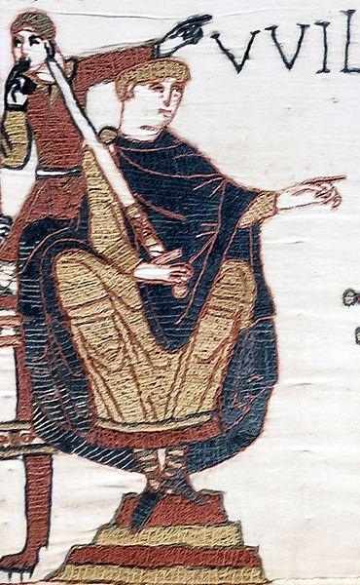
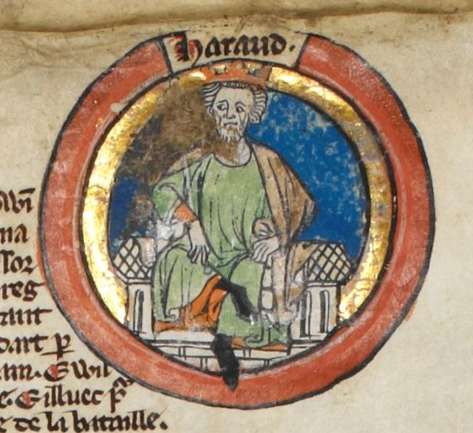

WHY DID WILLIAM OF NORWAY INVADE ENGLAND?
You have one minute to write down the answer, and we will discuss it after.
Wikimedia: Bayeux Tapestry –William of Normandy
Wikimedia: Harold Godwinson

