Slide 1

www.tweakteach.com
©2025 TweakTeach

Slide 2
Jainism and Buddhism 6 century BCE
To study the reasons behind the rise of Jainism and Buddhism
TO study the main features of Jainism and buddhism

Slide 3
Sources: Tripitaka
Vinaya Pitaka
Sutta Pitaka
Abhidhamma Pitaka
The rules and regulations of the Buddhist samgha. Disciplinary rules of the monastery are contained in this.
Buddha’s teachings and sermons
metaphysical discussions also mentioned by some sources as ‘higher teachings’
The main sources come from the second half of the 1st millennium BCE.
The Pali texts by the Buddhists are helpful.
In Pali, pitaki means ‘basket’

Slide 4
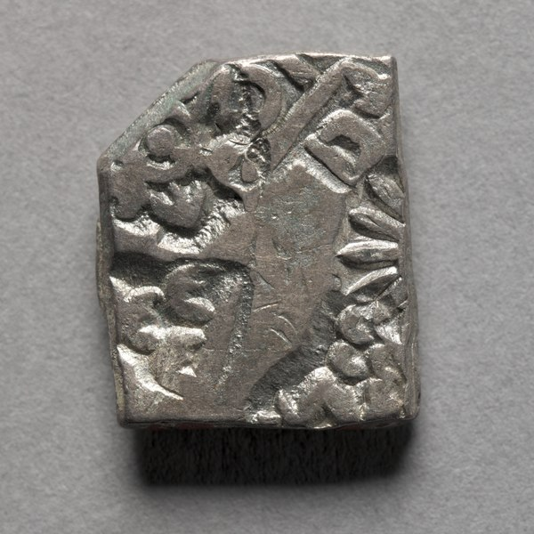
Reasons behind the rise of religious sects
Due to increased urbanization their was increase in trade and commerce. The use of the punch marked coins for trade has been found.
https://creativecommons.org/publicdomain/zero/1.0/deed.en
Social status of a few groups increased - the sethi who was a financier and was respected even by the kings
Write down why these reasons would lead to the rise of religious sects.
First Lets Think, Pair and Discuss
The gahapati controlled the wealth and also owned slaves both men and female. They were also moneylenders.
In the countryside the land came to be controlled by gahapatis (peasant proprieters). The meaning of the word has changed over time where gahapati was known as the lord of the house.

