Slide 1

www.tweakteach.com
©2025 TweakTeach

Slide 2

Indus Valley Civilisation
How advanced was the Indus Civilisation

Slide 3
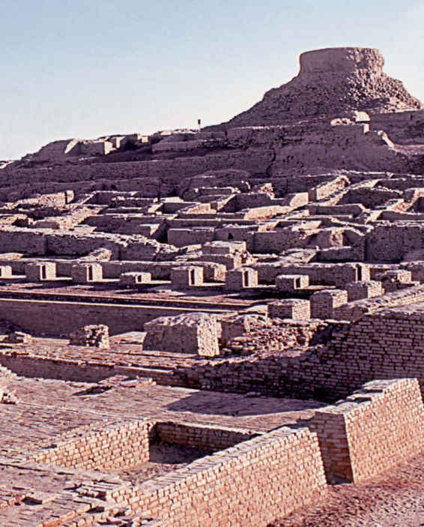
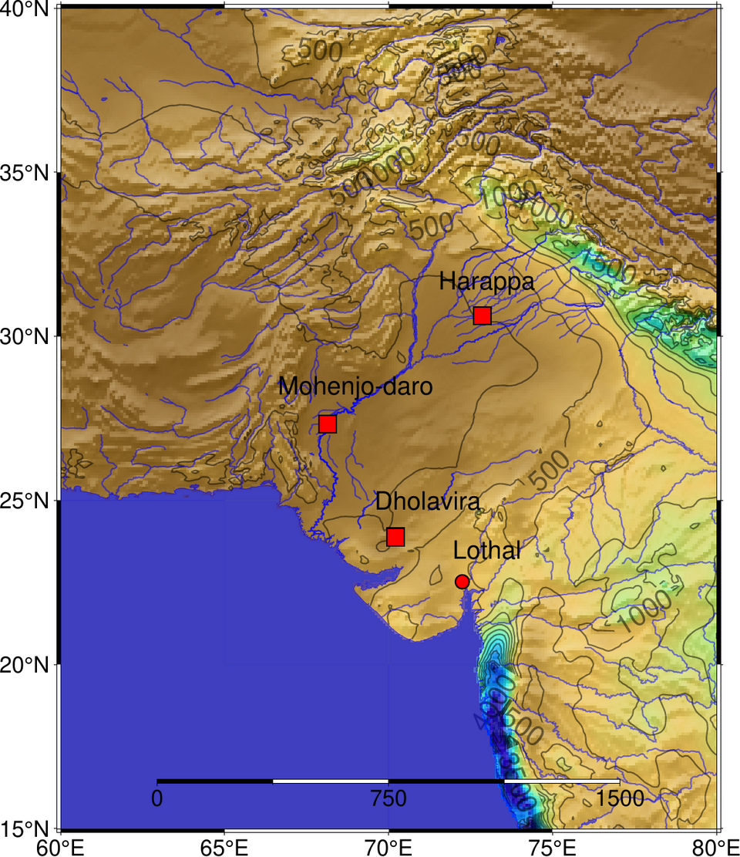
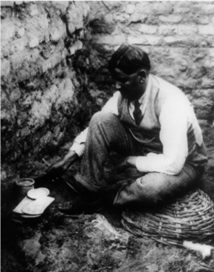
The Indus Valley Civilisation
The Indus Civilization is among the world's earliest civilizations and India’s earliest urban civilization.
It existed between 2500 and 1700 BCE.
The civilization was first discovered in the early 20th Century.
Its first sites were situated near the river Indus, therefore the name.
It had two major cities called Harappa and Mohenjo-Daro
MADHO SARUP VATS, WHO EXCAVATED HARAPPA
IN THE 1920S AND 1930S
CC0 1.0 Universal Public Domain Dedication

Slide 4

Why do you think the Indus River was important to the civilization?
Use these questions to write your answer –
Why was the river important for their everyday life?
Think, Pair, Share

