Slide 1

www.tweakteach.com
©2025 TweakTeach

Slide 2
THE HAN DYNASTY
(202 -220 CE)
TO STUDY WHETHER THE DYNASTY MARKED A PERIOD OF STABILITY AND INNOVATION

Slide 3
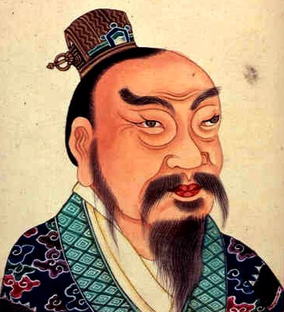
FOUNDER
Founded by Liu Bang who took the title of emperor’ in 202 BCE
The period is divided into subperiods and extends until 220 CE
There are periods when the succession of the ruler was in the same family
The empire ruled for 400 years
Five leaders occupied the throne until 87 BCE
Wikimedia: Emperor Liu Bang
Notes:
https://commons.wikimedia.org/wiki/File:Emperor_gao_of_han_c01s06i01.jpg

