Slide 1

www.tweakteach.com
©2025 TweakTeach

Slide 2

Qing Dynasty – The First Opium War
1839-1842
Did the Opium Wars lead to the decline of the Qing Dynasty?

Slide 3
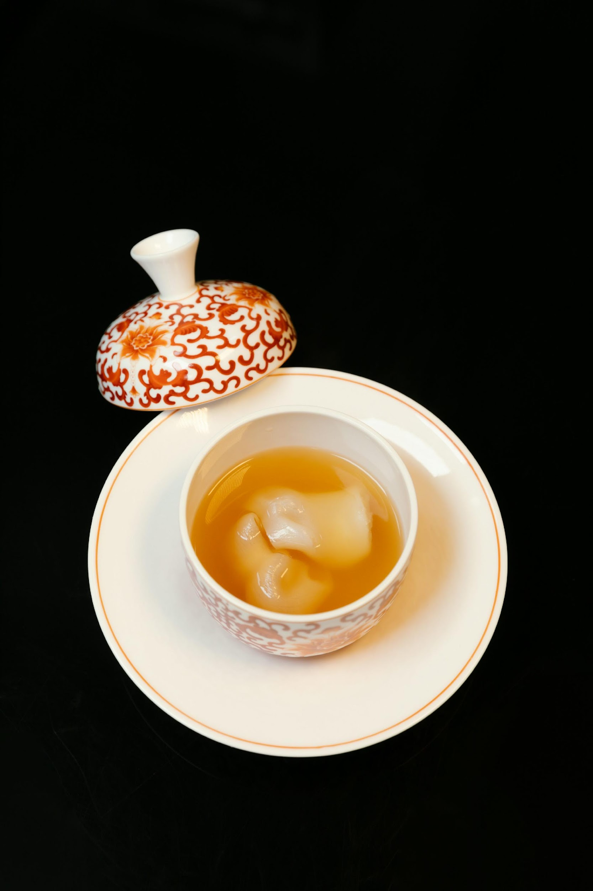

Relationship with Britain
China has always been suspicious of Britain and, therefore, did not allow Western traders to use the ports of Guangzhou, now Canton
Due to China’s internal problems, including the increase in population, foreign trade increased by 4% between the 18th and 19th centuries.
Chinese porcelain, silk, and tea were valued products in Britain.

