Slide 1

www.tweakteach.com
©2025 TweakTeach

Slide 2
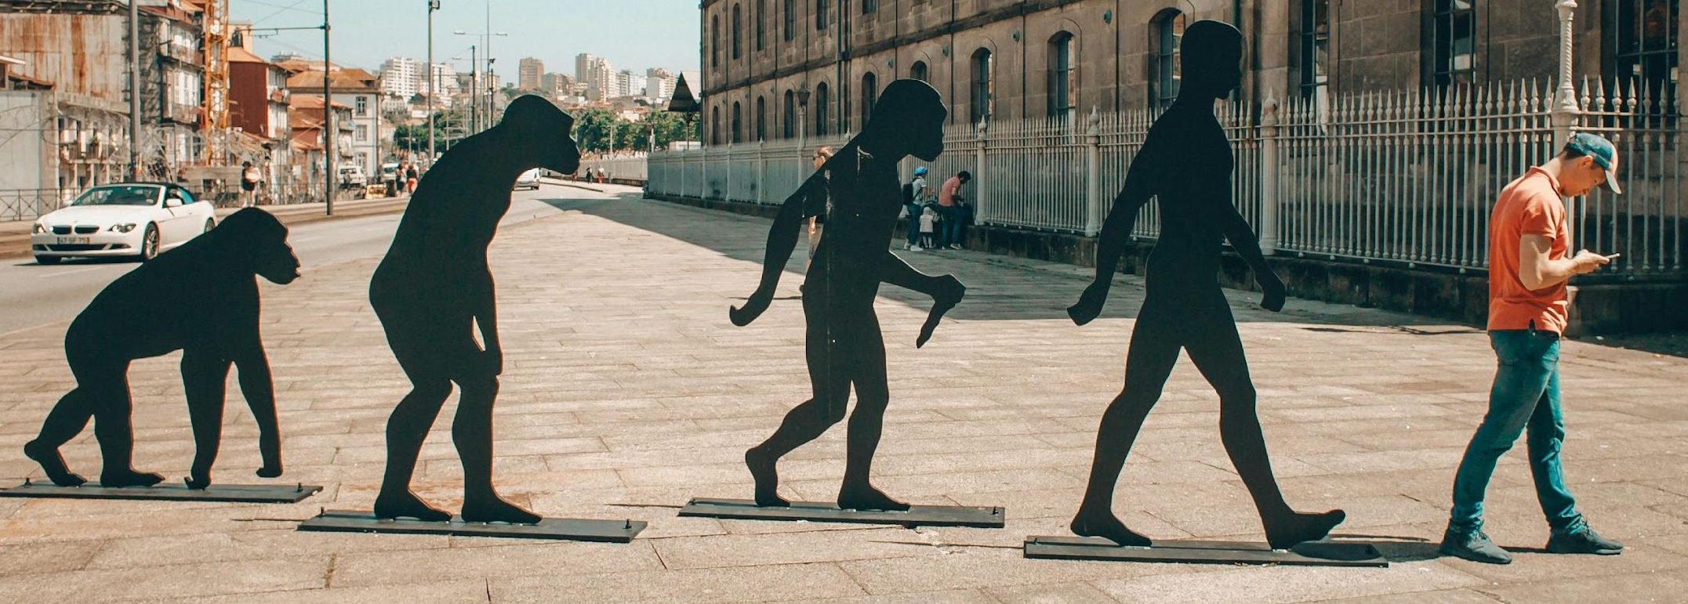
THE FIRST HUMAN BEINGS AND THE THEORY OF EVOLUTION
Aim: To study the origins of the first human beings and the Theory of evolution

Slide 3
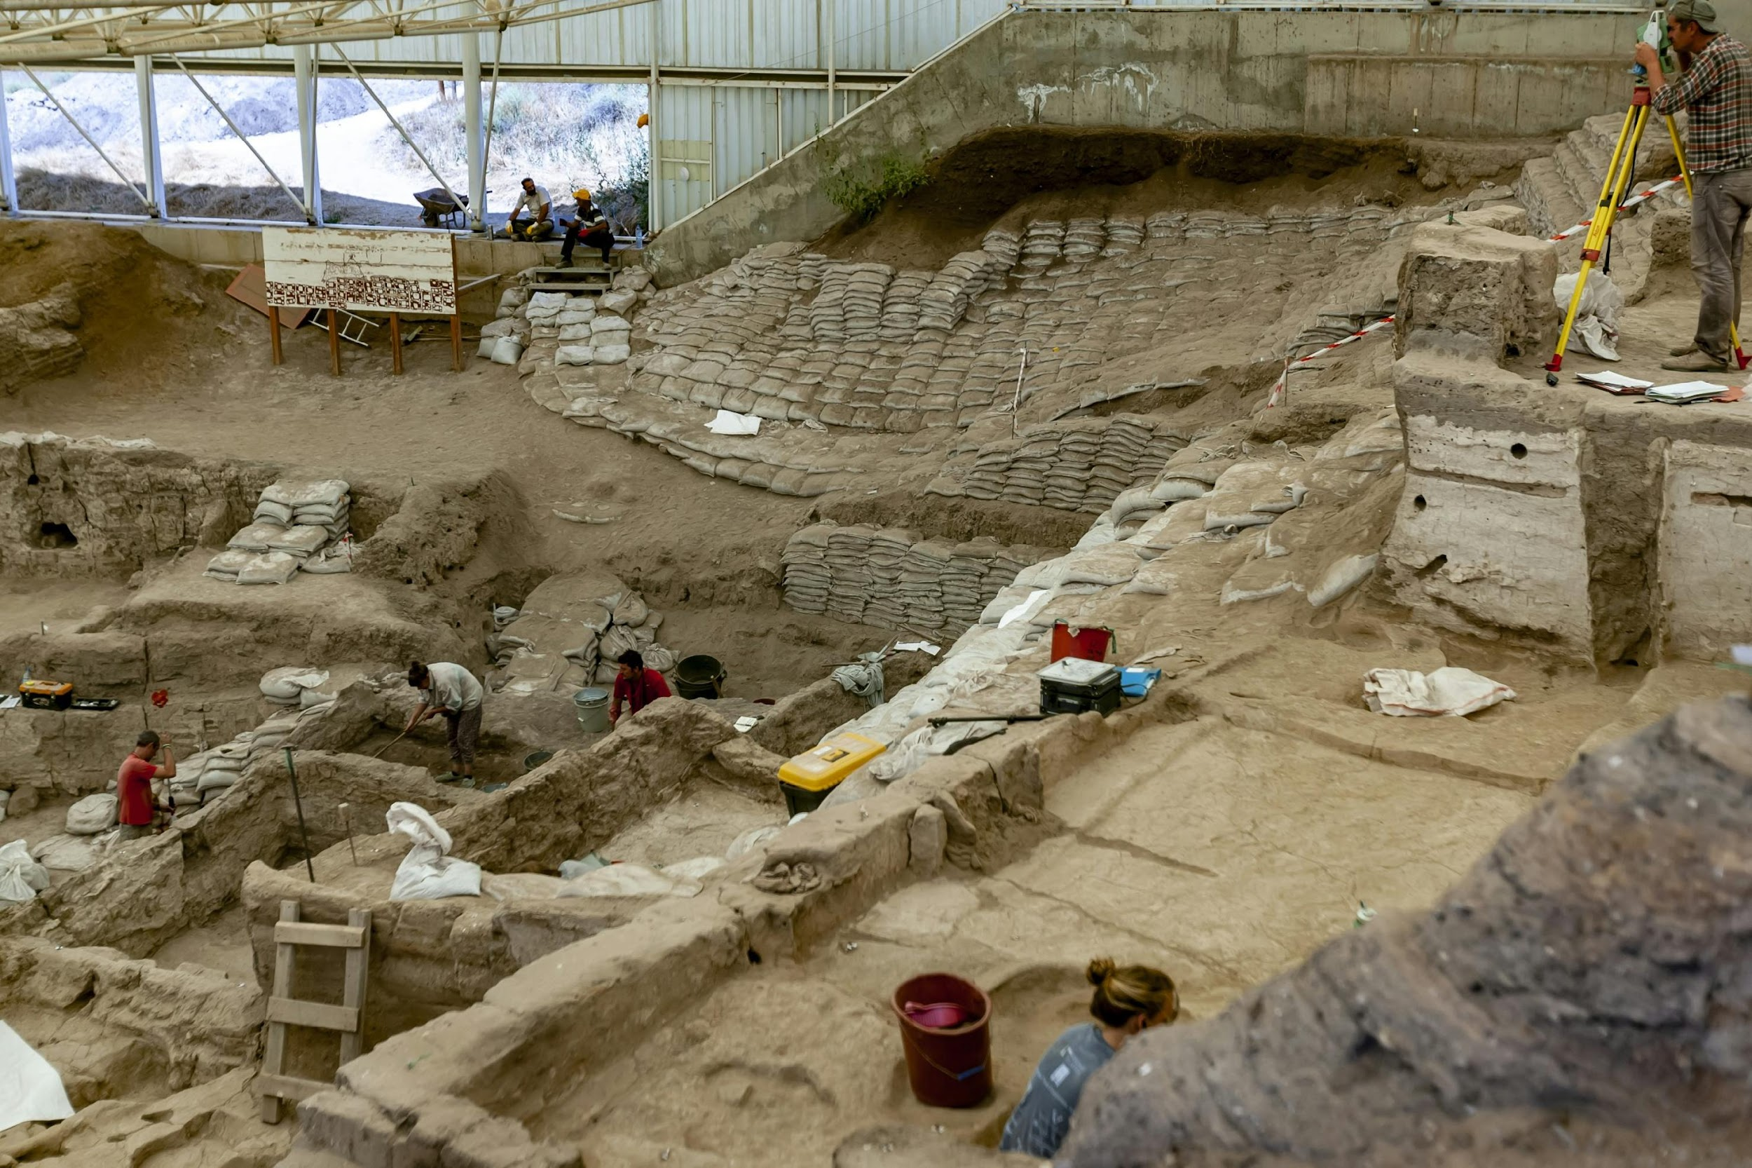
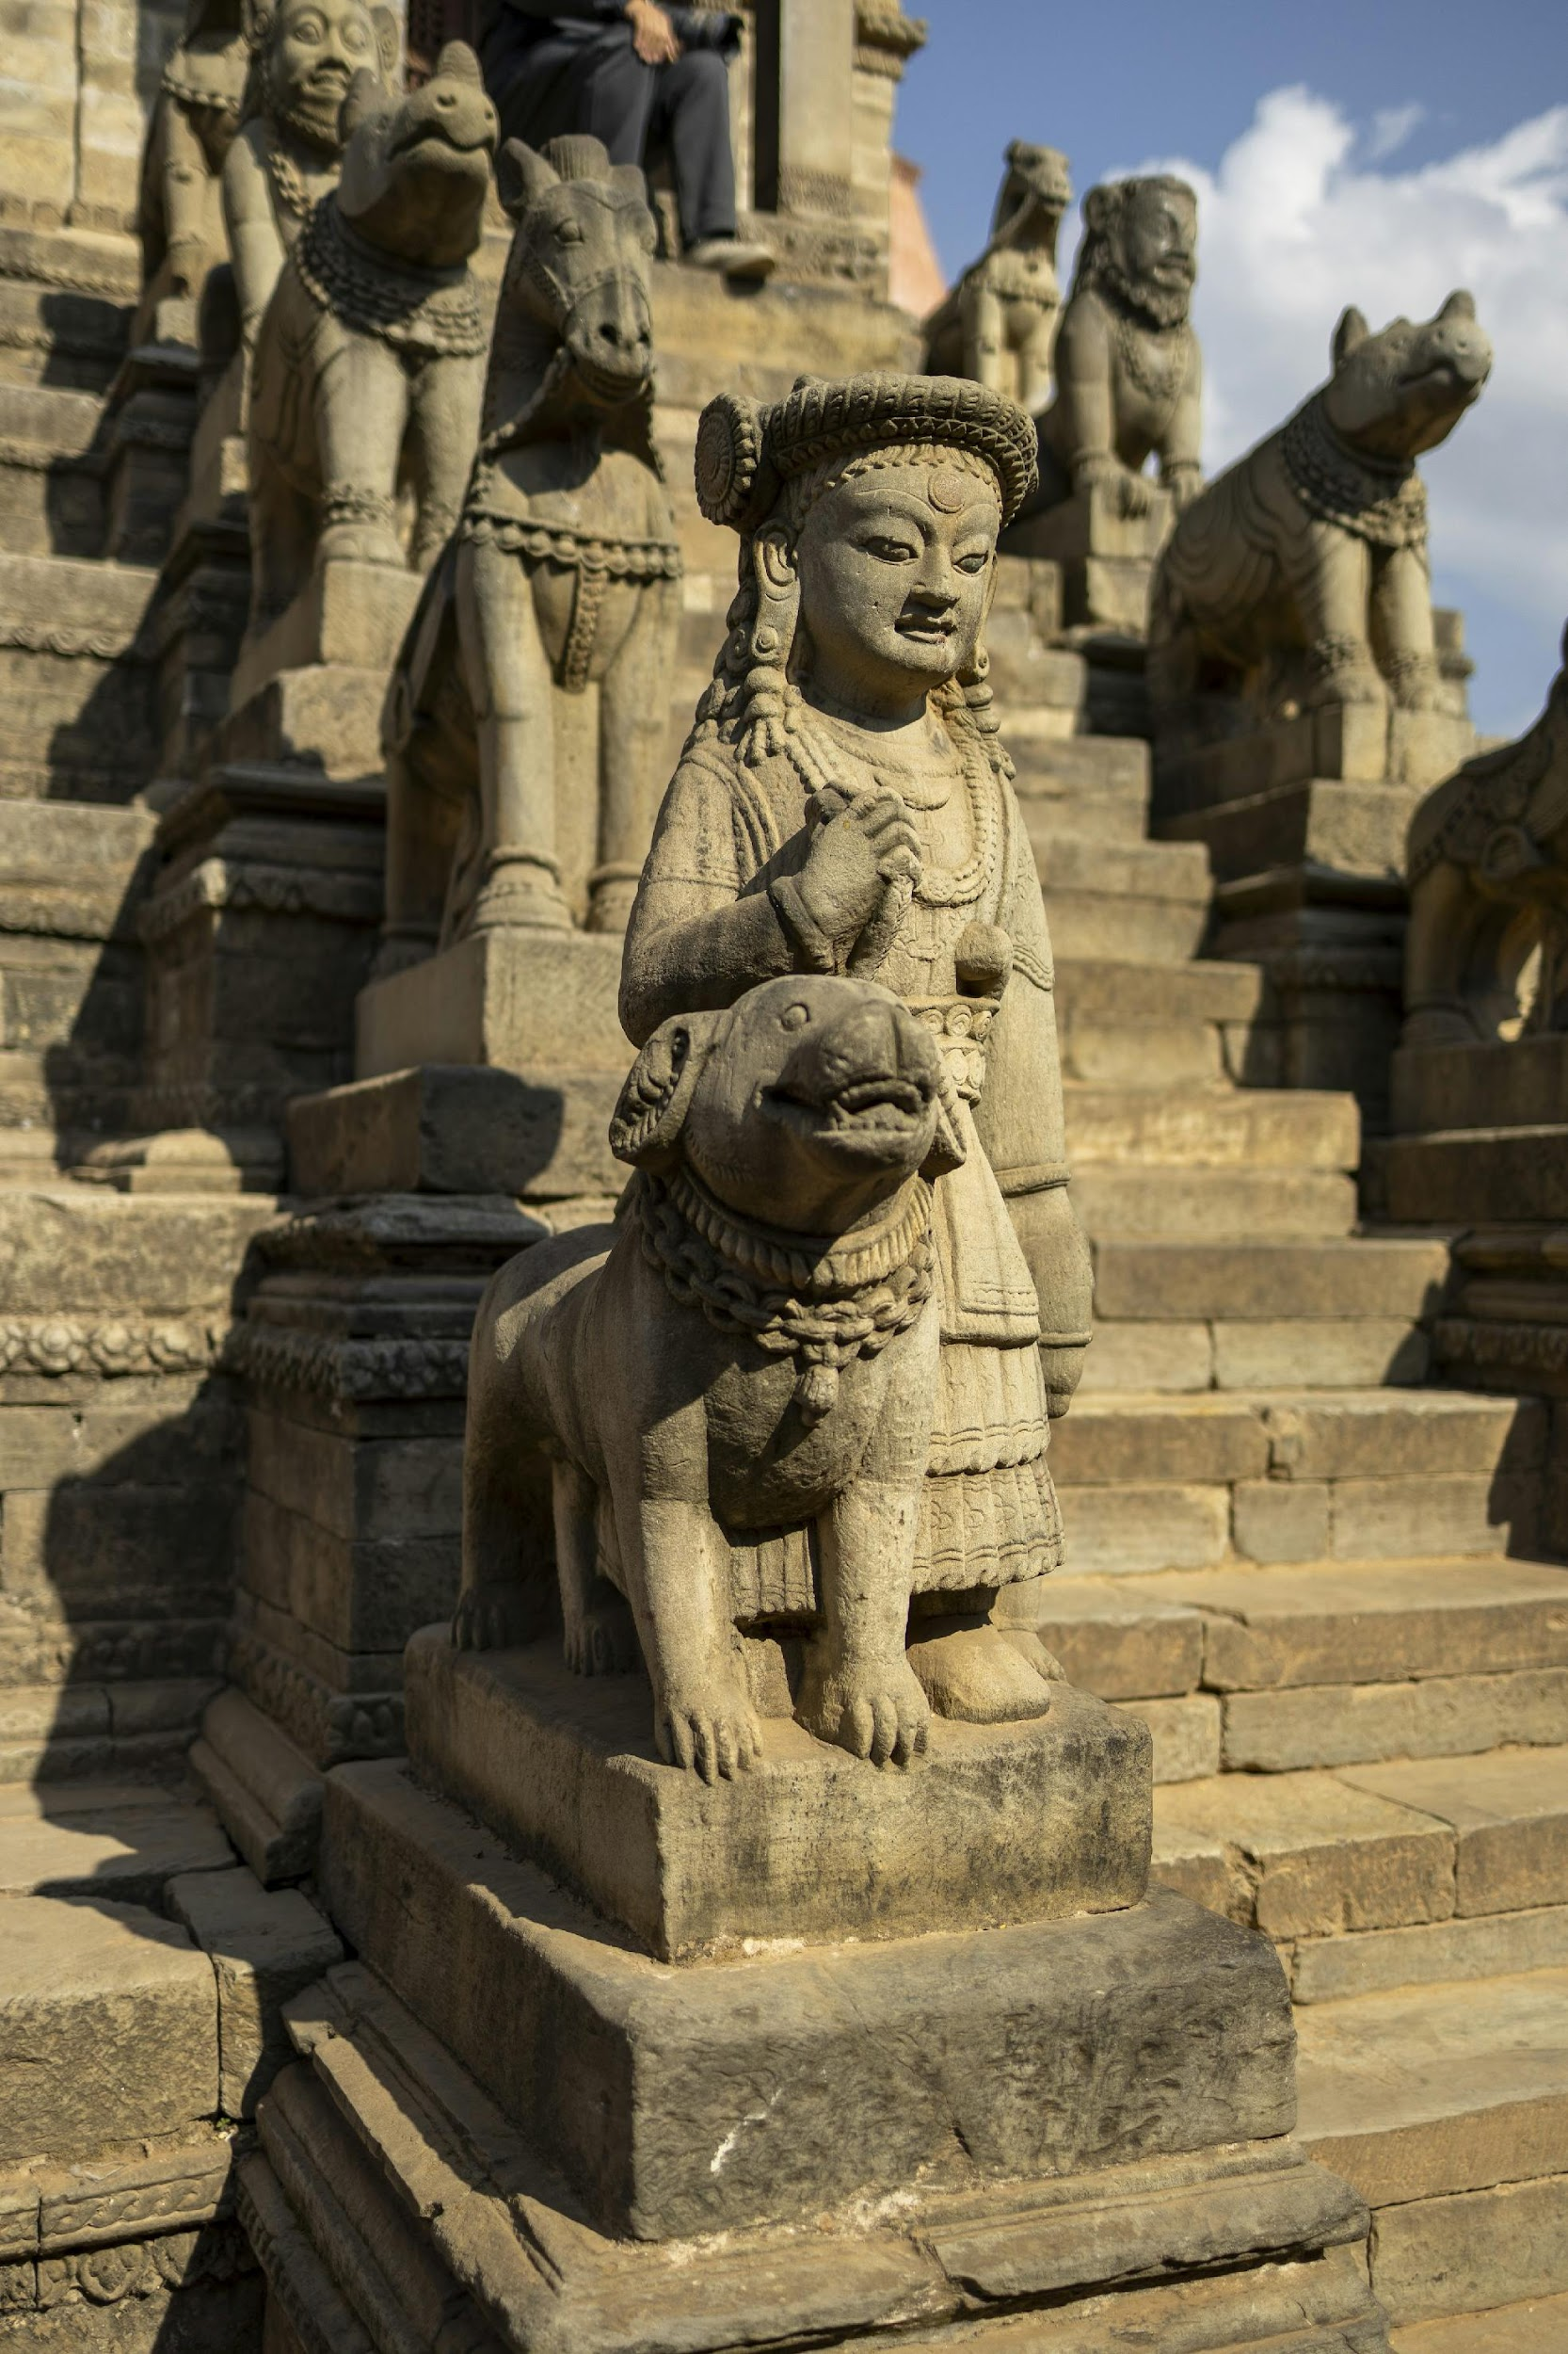
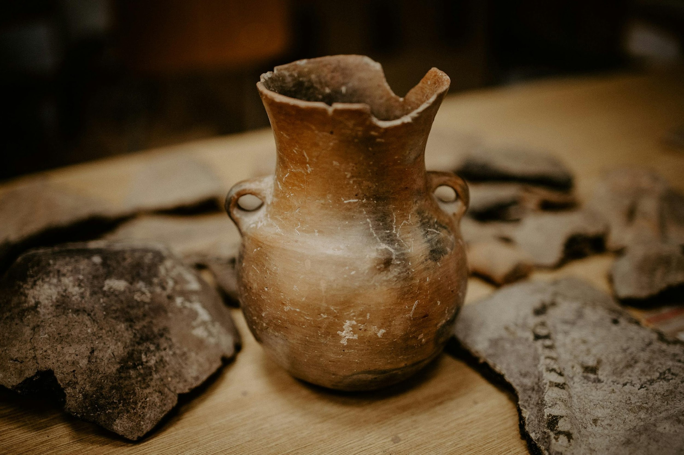
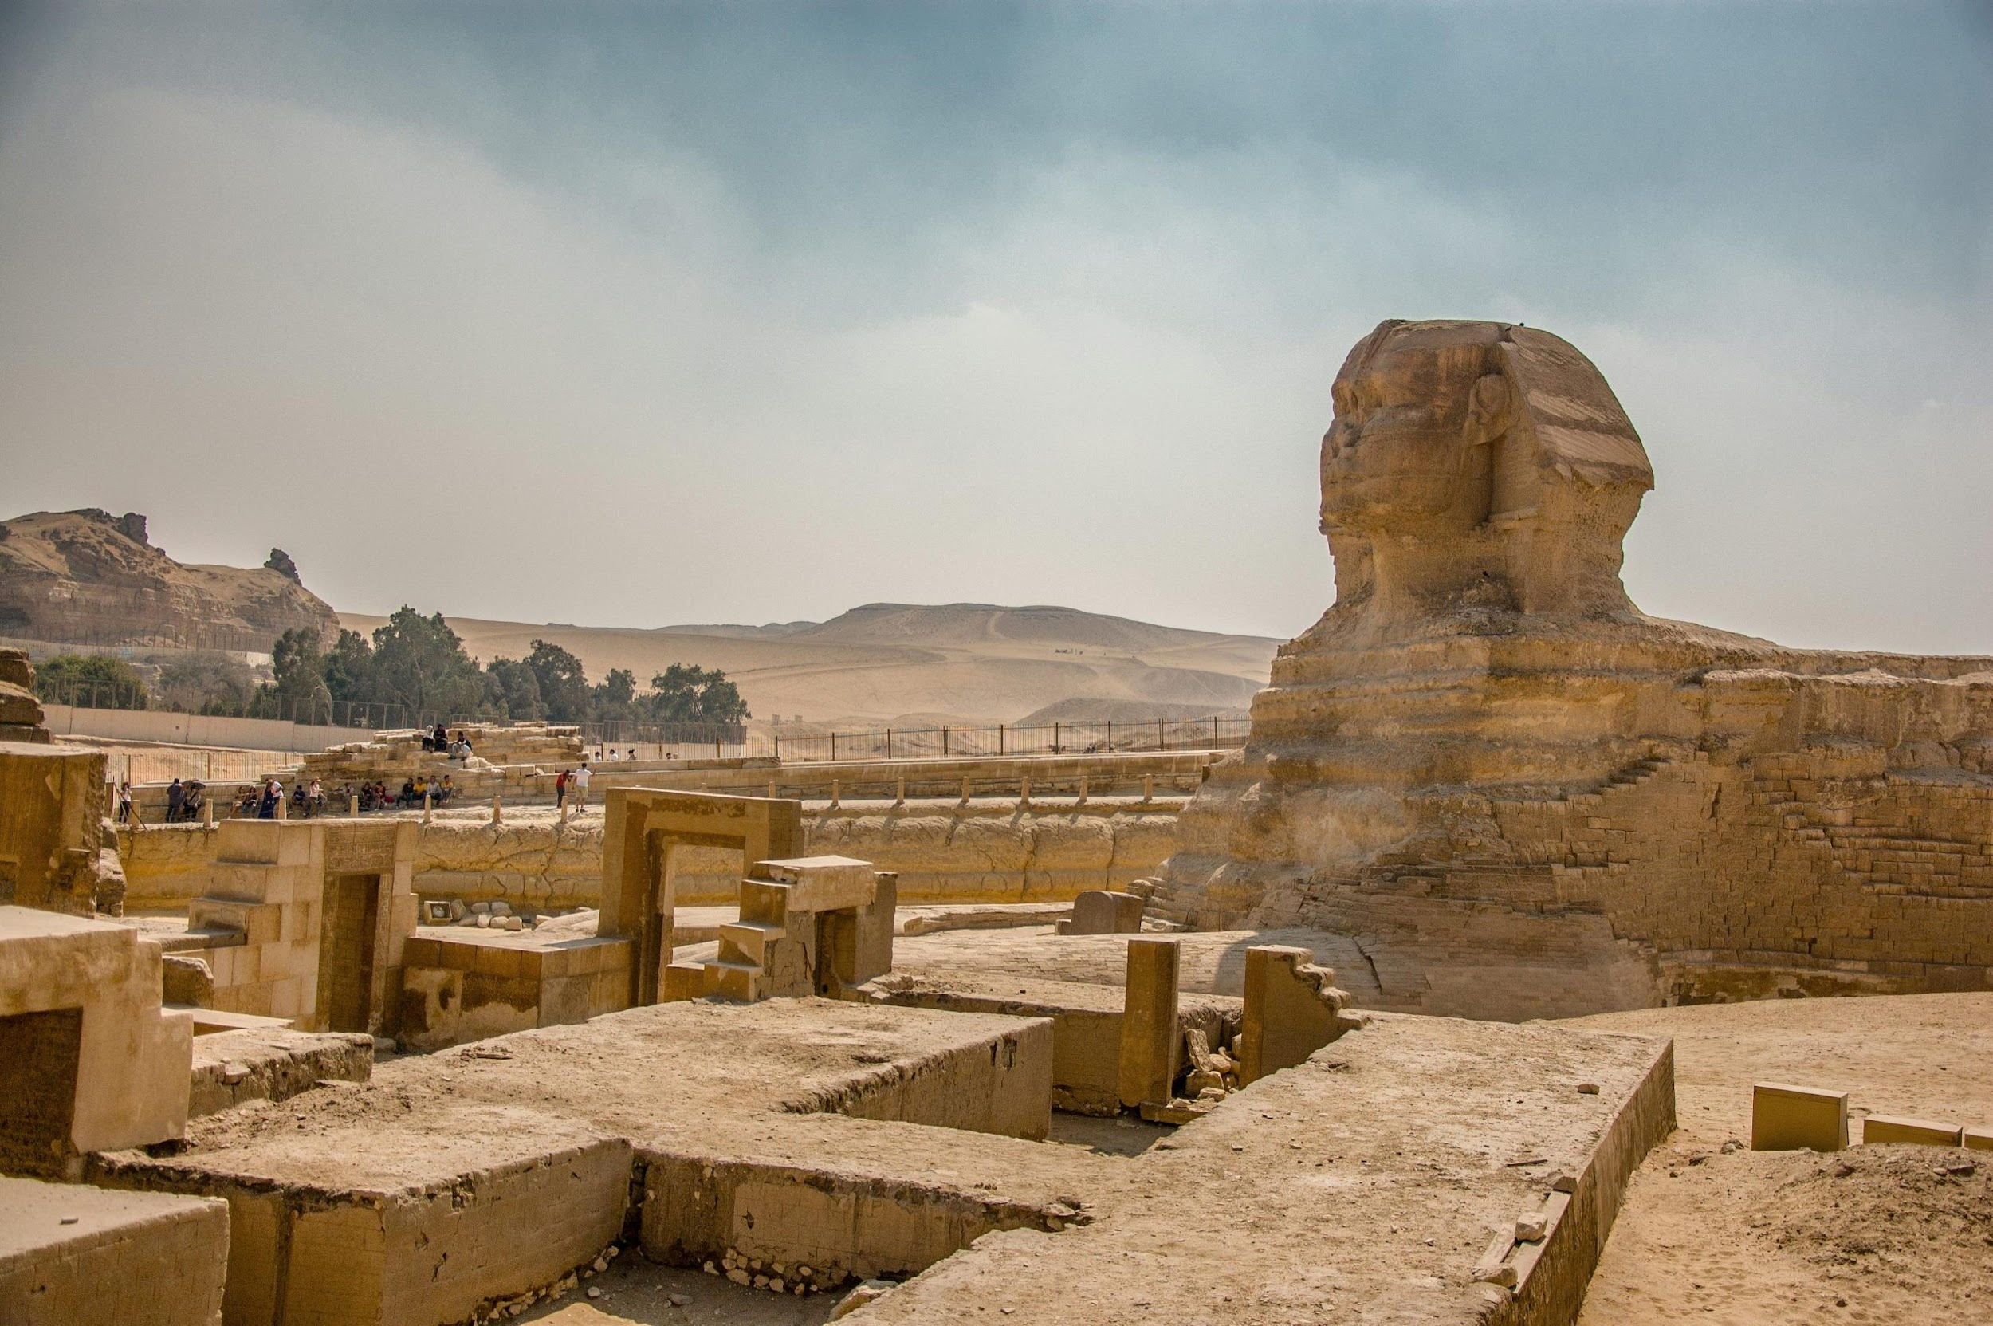
HAVE A LOOK AT THESE PICTURES CAREFULLY – WHY ARE THESE IMPORTANT FOR AN HISTORIAN
Who can give me the answer to this question –
The person who studies history by analysing ancient sites, and relics from the past is known as an -
Notes:
Archeologist

