Slide 1

www.tweakteach.com
©2025 TweakTeach

Slide 2
THE FALL OF THE ASANTE KINGDOM
What led to the fall of the Asante empire?

Slide 3
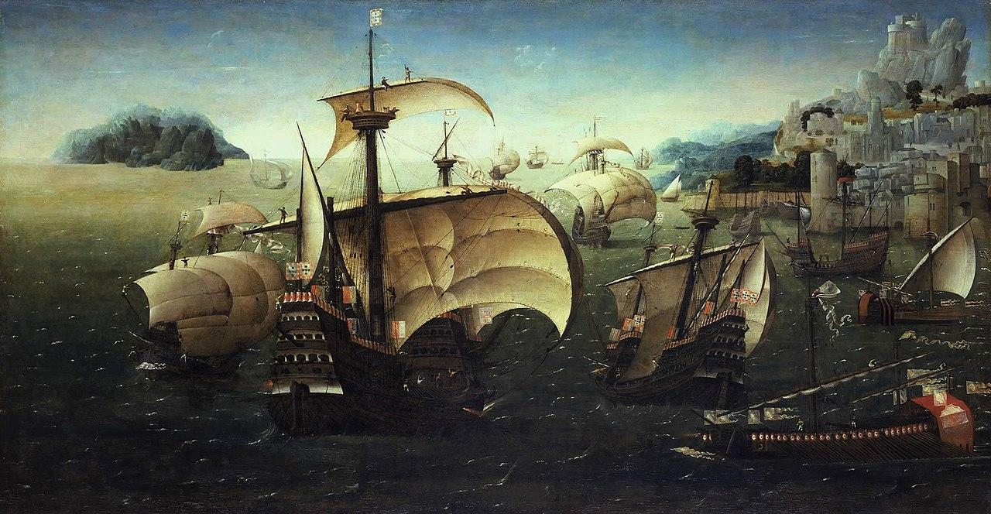
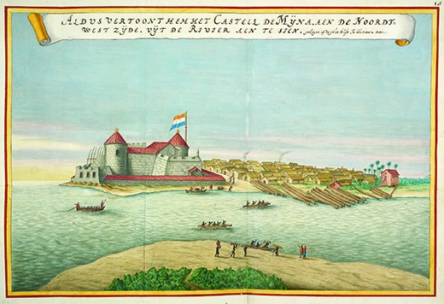
The Portuguese and the Akan Community
This Photo by Unknown Author is licensed under CC BY-SA
The Portuguese entered West Africa to explore what they called the Gold Coast.
They came in touch with the Akan communities, which were further south from the Kingdom of Mali.
The Portuguese started trading gold and enslaved people in exchange for cloth and firearms.
Fill in the gap on your worksheet
This Photo by Unknown Author is licensed under CC BY

Slide 4
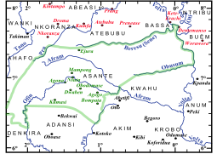
The Asante
In 1701, the Akan communities joined together under the Asante
The Asante also traded enslaved people with the Portuguese and the Europeans.
The enslaved people were taken to the Americas to work in the plantations.
Wikimedia: Map of Asante Empire
Fill in the gap on your worksheet

