Slide 1

www.tweakteach.com
©2025 TweakTeach

Slide 2
THE WAR AT ITS END
PART 2
To understand the main events leading up to the end of WW1

Slide 3
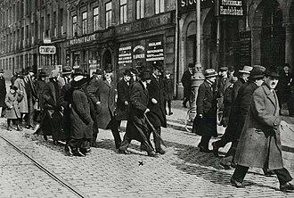
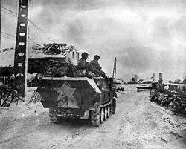
Recap
Why did the USA declare war on Germany?
Think, Pair, Share

Slide 4
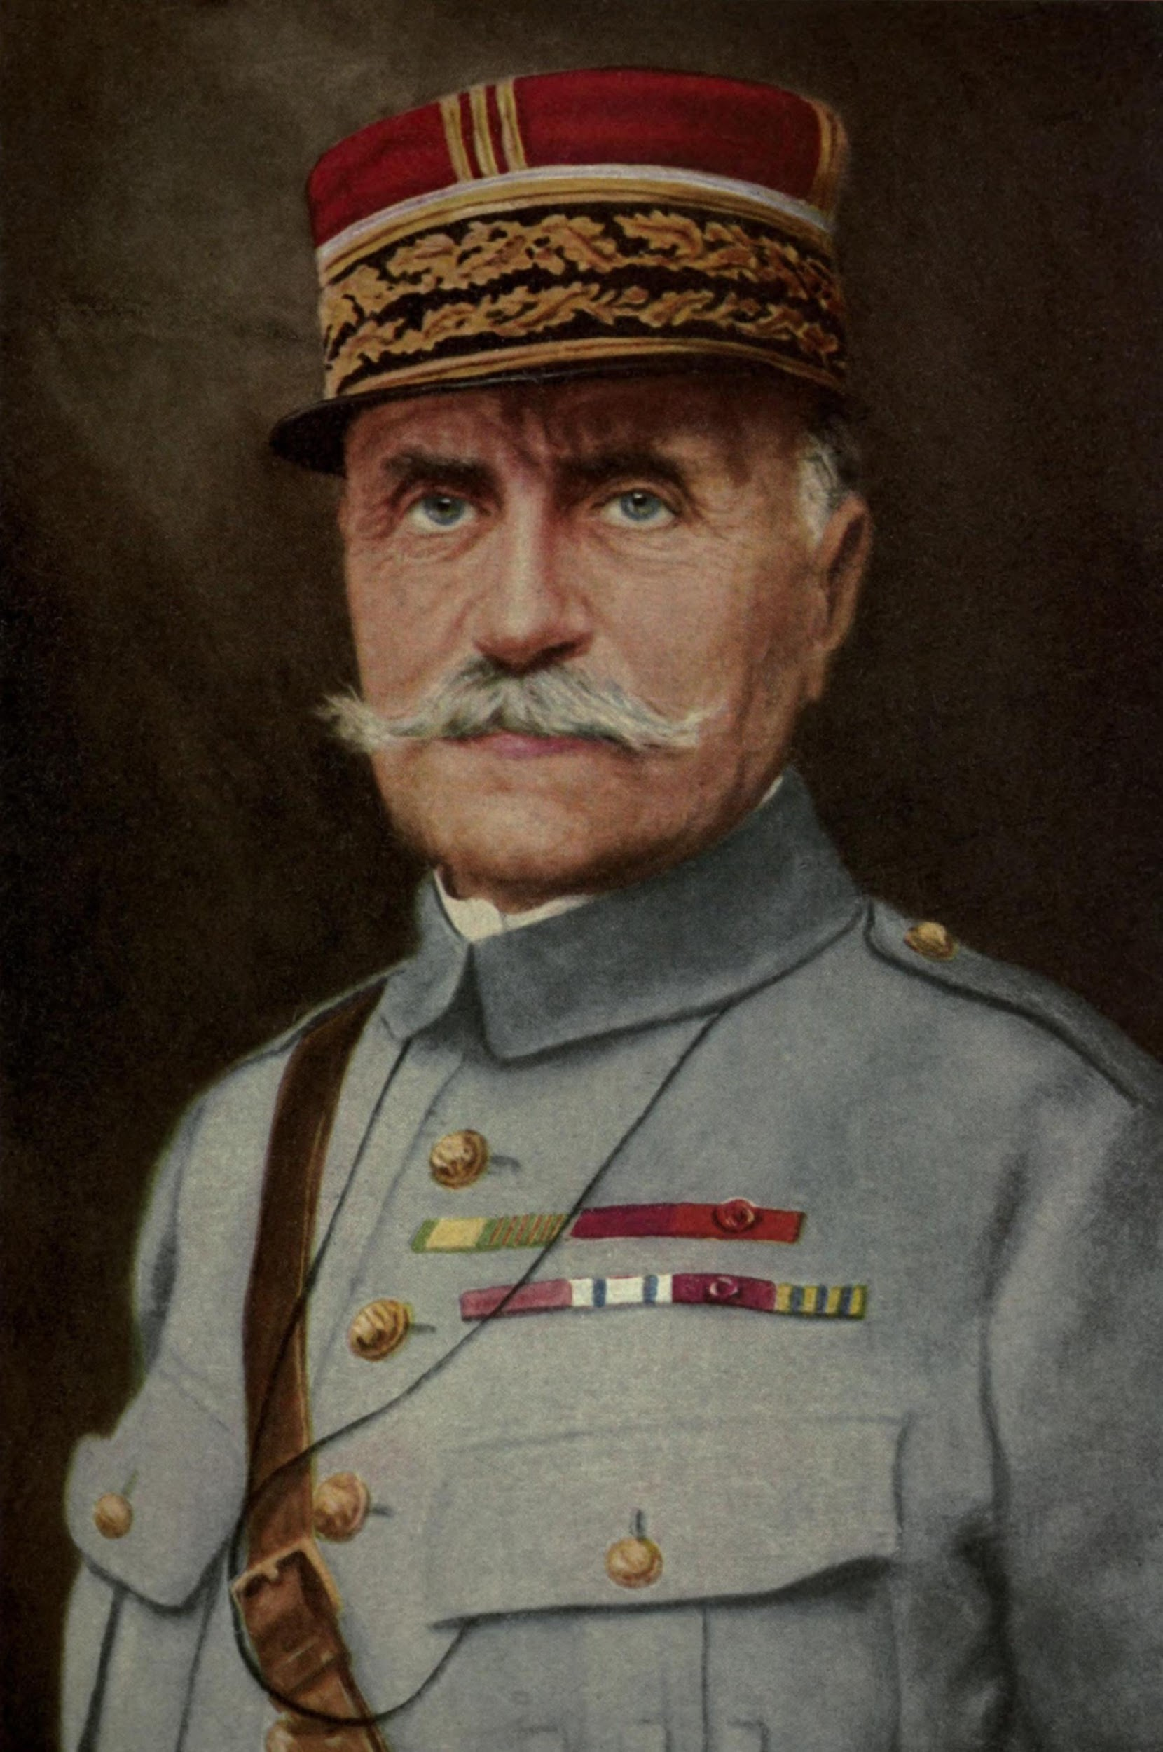
The 100-day Offensive
2nd Battle of the Somme
 | Battles | Advantage | Disadvantage | Impact/result
Germany
USA/Britain
The Allies were now materially and psychologically prepared to launch the Offensive - Think, Pair, Share Why?
The American Expeditionary Force was commanded by General Foch
The first attack was launched on Amiens on 8 August 1918
The Allies, with their artillery barrage, managed to create a 25 Km gap south of the River Somme
48000 German soldiers in total were killed, wounded, or captured
Ludendorff described it as the Black Day and knew that the Germans would not win the war
General Foch
Notes:
The town of Roye was located in the Somme
Fill in the table. - Here the disadvantages of the German side and the advantages of the British side should be written. The impact needs to be written by the pupil according to their analysis and the possible outcome of the war.

