Slide 1

www.tweakteach.com
©2025 TweakTeach

Slide 2
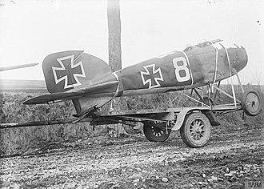
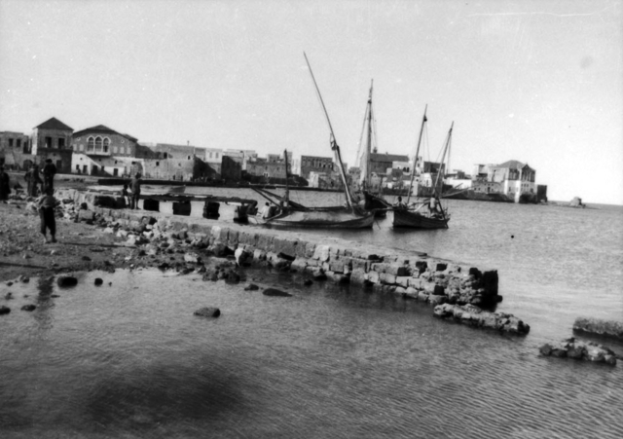
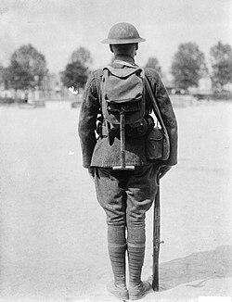

THE WAR COMES TO AN END
To study the reasons leading to the end of the First World War

Slide 3
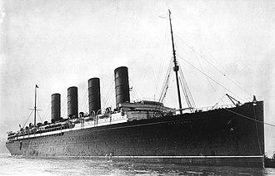
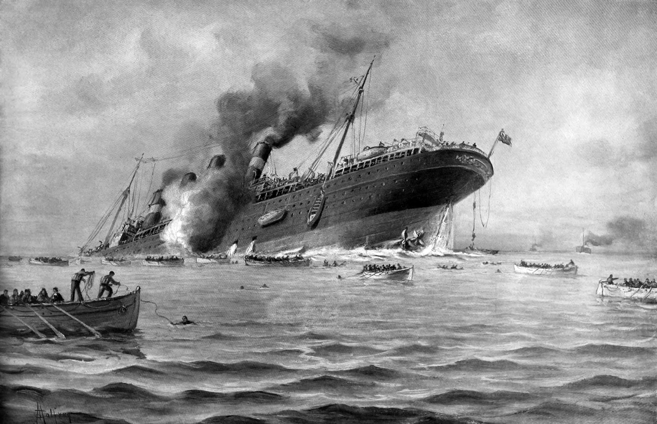
THE SINKING OF THE LUSITANIA - 1915
A German U-boat sank a passenger liner travelling from New York
The Germans broke international codes, but the Allies were also in the wrong, as the ship was carrying weapons
The ship contained American citizens
Why was this significant? Think, Pair, Share

