Slide 1

www.tweakteach.com
©2025 TweakTeach

Slide 2
INDUS VALLEY CIVILISATION
Aim: To study the decline of the Indus Valley Civilisation

Slide 3
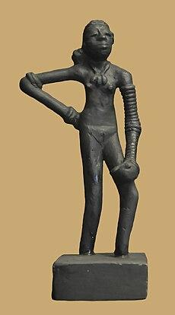
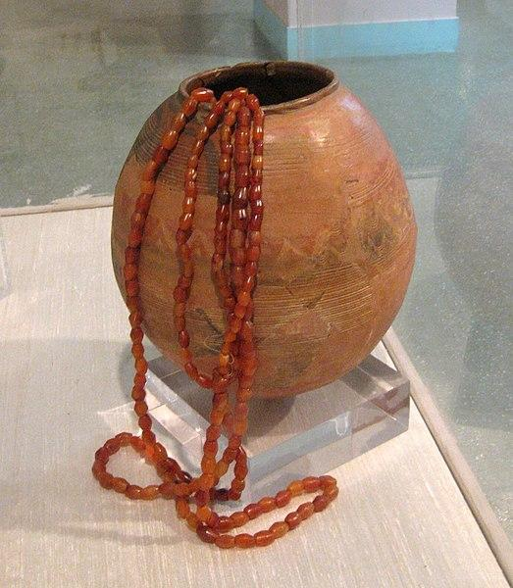
YOU COULD USE THE INFORMATION BELOW OR ANYTHING YOU REMEMBER
Write down one point under each heading that would summarise a feature of the Indus Valley Civilisation:
Socio-Economic Life
Religion
Trade
Crafts
Technology
Wikimedia: Vase, Beads, and Dancing Girl

Slide 4

You could use the information below or anything you remember
Beads and bracelets were found, which meant that there were craftsperson who were skilled in shell working.
Ivory and bone working was also present.
The Harrapans produced a large number of items, such as ceramics and different kinds of pots.
Harappans worshipped a female goddess. Historians have come to this opinion because of the discovery of a large terracotta figurine labelled as the mother goddess.
They also worshipped male gods
The Indus Civilization was an urban civilization because of its advanced systems of drainage and city planning.
The Indus civilization was a farming civilization and they also domesticated animals.
The people acquired resources from the river when it was available.
Evidence showed that there were several trade routes, and the communities were well connected.

