Slide 1

www.tweakteach.com
©2025 TweakTeach

Slide 2




How did William Change ENgland?
Keywords:
Motte and Bailey – type of new castles built by William

Slide 3
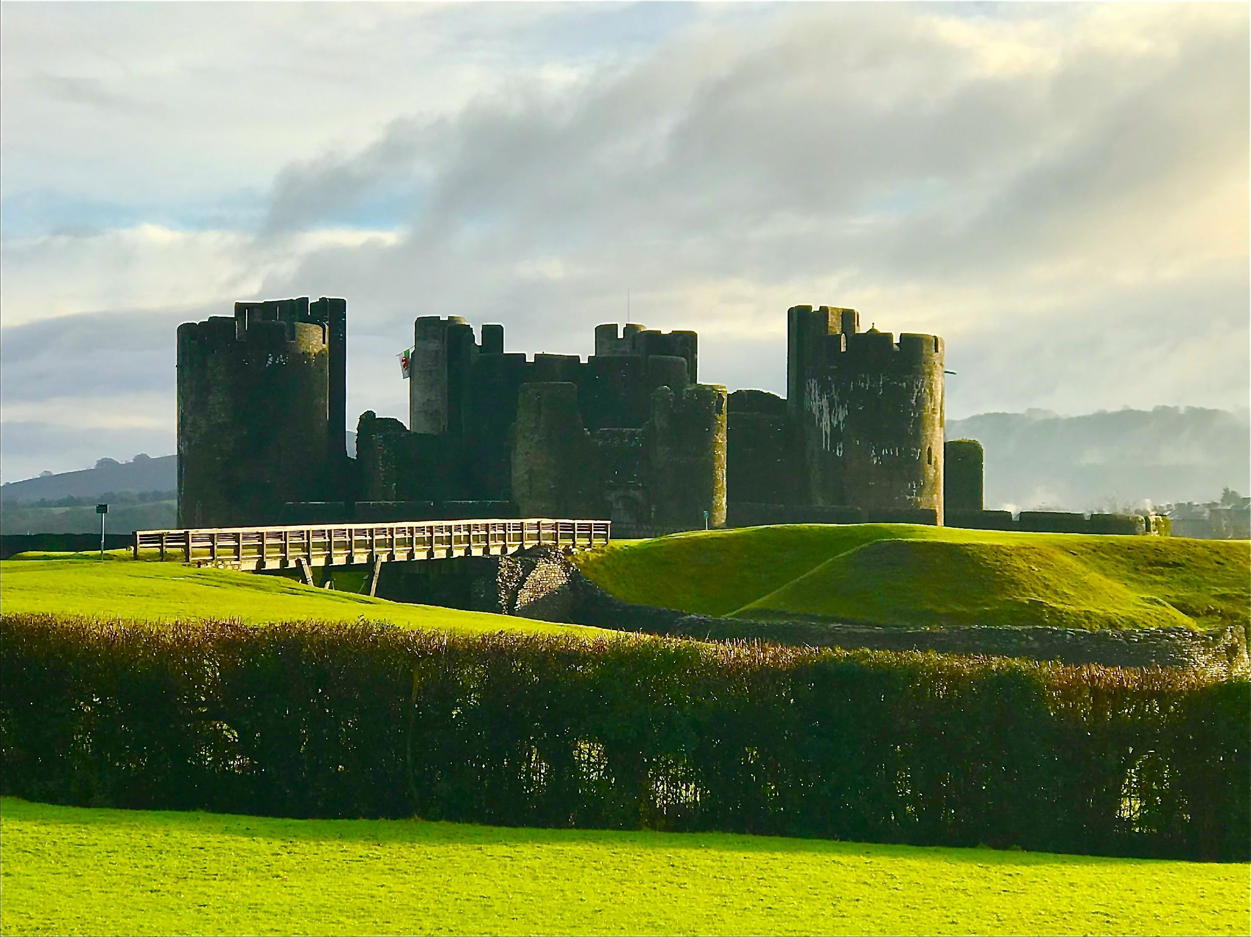
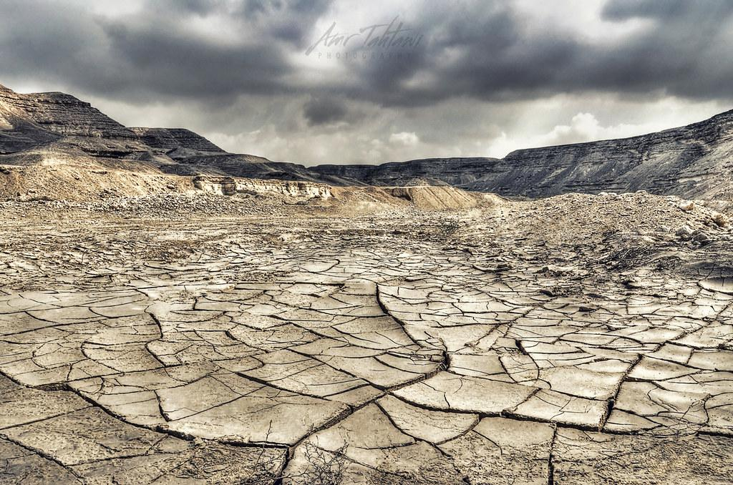
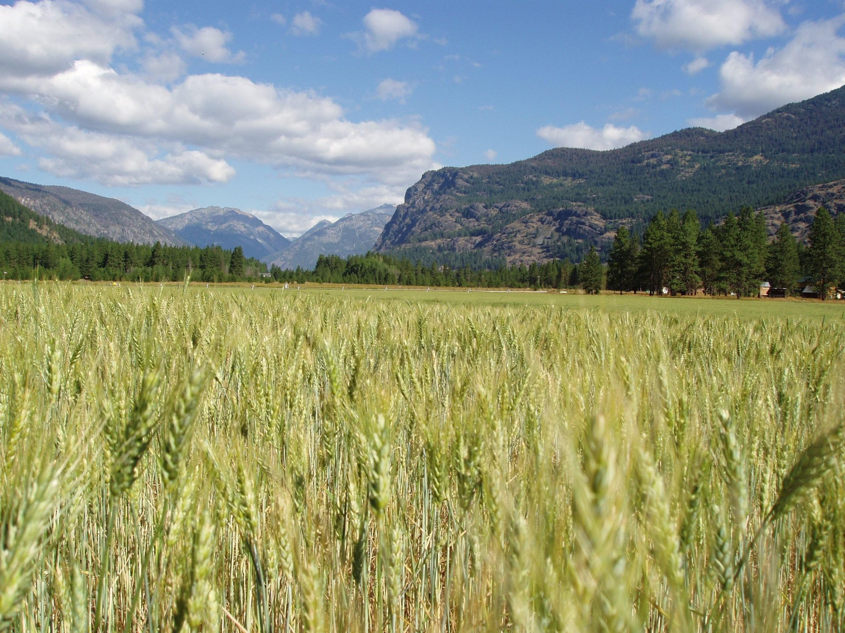
What do you see in the pictures – Can you tell me the changes that William made ?
This Photo by Unknown Author is licensed under CC BY-NC-ND
What opposition was there to William's rule?
This Photo by Unknown Author is licensed under CC BY

Slide 4
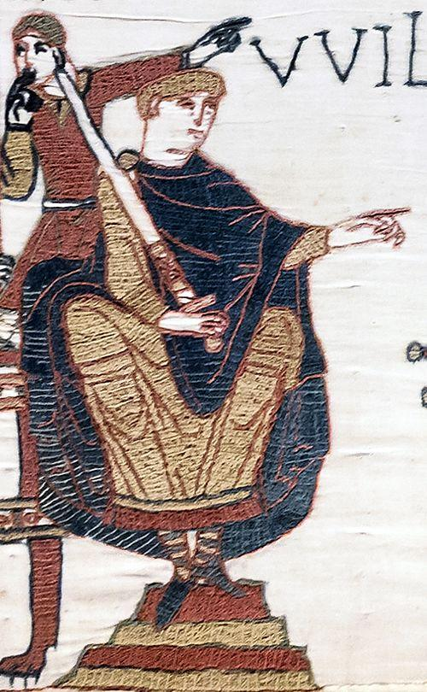
HOW DID THE NORMANS CHANGE ENGLAND?
William changed policies regarding land ownership. Before the Normans, there existed earldoms that were owned by Anglo-Saxon earls. William divided the land further and gave them to the Normans.
Get ready to discuss with the class.
Go through this information sheet.
You have one minute.
William introduced new laws like hunting in the riyal forests was not allowed and you could be blinded.
Normans built castles, which acted as a defense as wall .
The Normans were French, and ordinary people spoke English. French words were introduced into the everyday language gradually. E.g., baron, market
Normans built churches made of stone, replacing the earlier wooden architecture.
Notes:
Give the pupils a copy of this slide

