Slide 1

www.tweakteach.com
©2025 TweakTeach

Slide 2
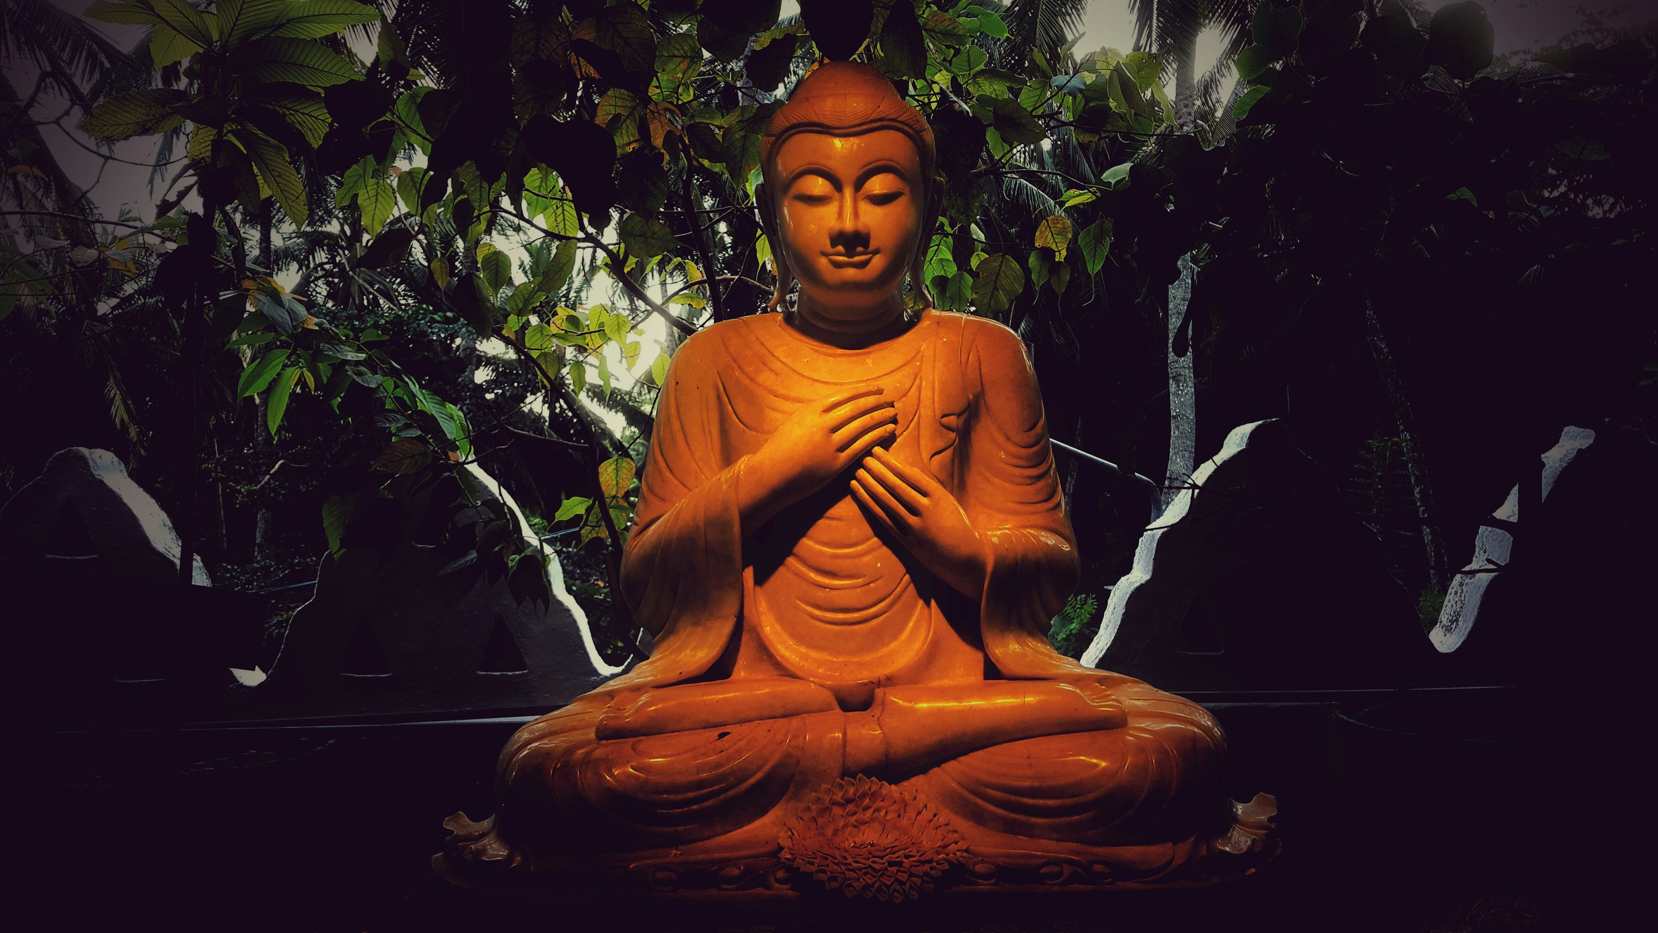
The Rise of Buddhism in India
To study the main features of Buddhism
To investigate the reasons behind the rise of Buddhism?
How far was it challenging social norms?

Slide 3
Conditions in the 6th century BCE – Gangetic Plain
Brahmanical traditions practice divisions in society based on varna.
The lower castes, mainly the shudras, did not have rights and were destined to serve the upper caste.
Traditions practiced animal sacrifice
Peasants working on farm lands relied on animals for economic growth
An increase in wealth during this time led to greater divisions in society
New social groups rose in towns based on wealth and not caste
Why do you think the new social groups were against the Brahminical traditions?
Think, Pair, Share
Notes:
The caste system was rigid and did not allow lower caste the option of gaining higher status. The new wealthy groups therefore, went against these traditions to make a place for themselves in the upper rungs of the society

Slide 4


SHOW ME
Would you agree that the new social groups wanted to build a new social order where they would be respected? This led to the rise of new religious sects like Buddhism.
This Photo by Unknown Author is licensed under CC BY-SA
Notes:
Discuss the reasons with the students.

Slide 5
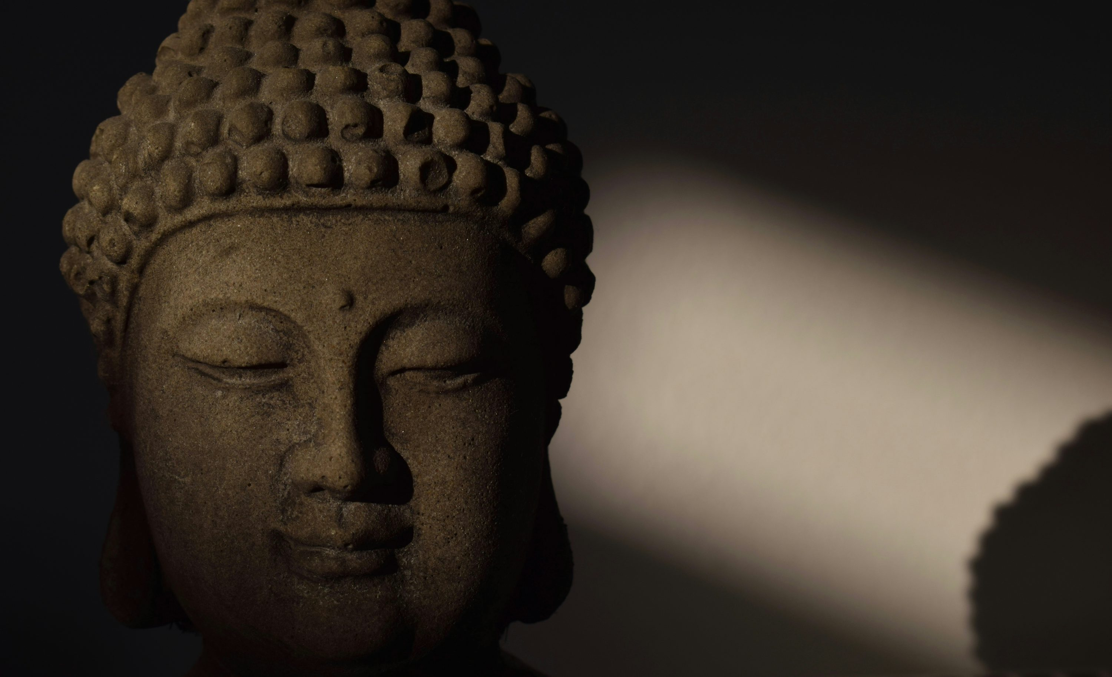
Gautama Buddha
Also known as Siddhartha, was born in 586 BCE
He was a prince and received training in warfare
He was also married to his cousin and had a son named Rahula
He left his home at the age of 29

