Slide 1

www.tweakteach.com
©2025 TweakTeach

Slide 2
WHO BECOMES KING OF ENGLAND?
To study the events leading to the coronation of the new King of England

Slide 3
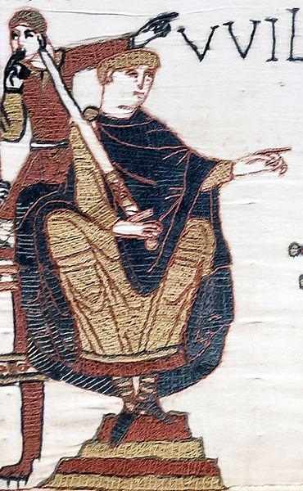
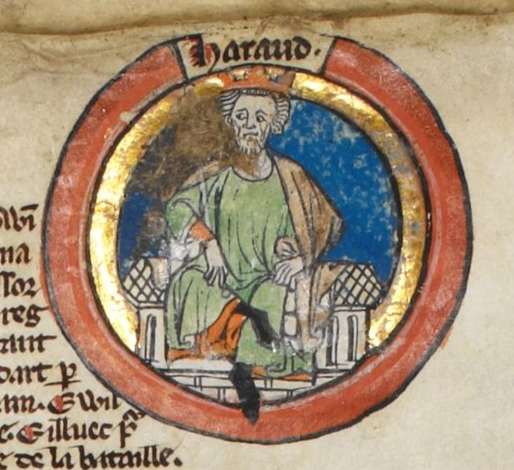
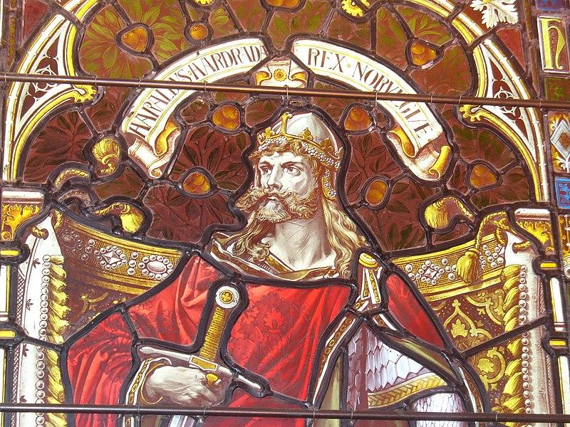
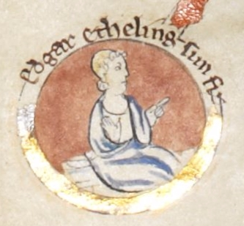
THE CONTENDERS FOR THE THRONE
Harold Godwinson
Harald Hardrada
Duke William of Normandy
Edgar Aetheling

Slide 4
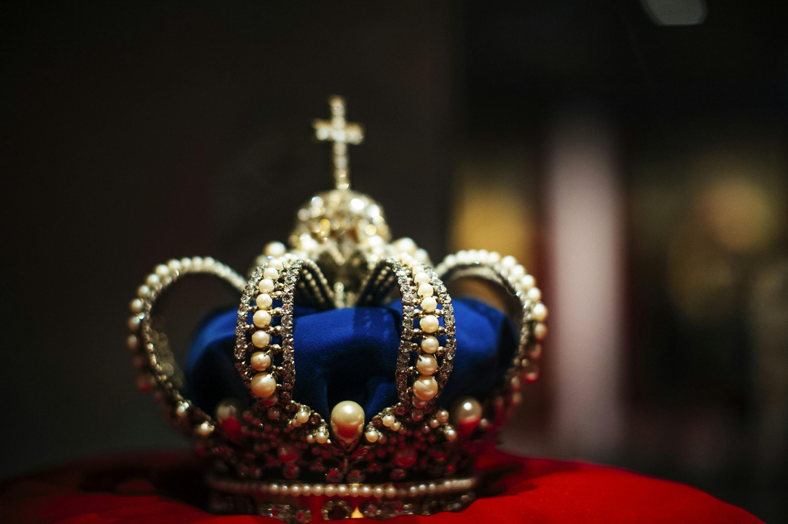
THE THREAT TO THE NEW KING
Harold Godwinson or Harold II was crowned King
Harold knew that there were threats to his rule.
Duke William of Normandy was preparing to attack and claim the throne
While, Harold’s brother Tostig formed an alliance with Harald Hardrada, the Viking King.

