Slide 1

www.tweakteach.com
©2025 TweakTeach

Slide 2
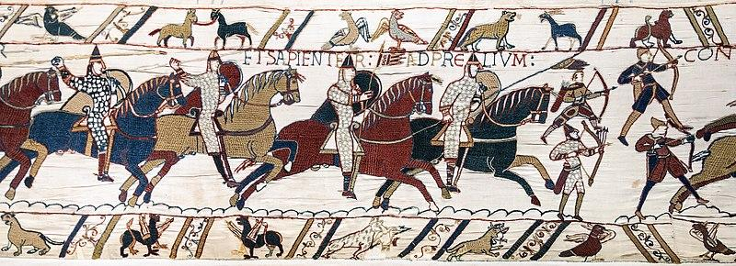
THE BATTLE OF HASTINGS
To study the events and the significance of the Battle of Hastings

Slide 3


TRUE OR FALSE
Harold Godwinson was crowned King.
Harald Hardrada won the Battle of Fulford.
Harold Godwinson lost the Battle of Stamford Bridge.

Slide 4

ENGLISH ARMY
KEYWORD ALERT
Housecarls – They were professional soldiers
Fyrd Levies – These were armies made up up of men who were physically strong and could fight
Thanes – Feudal Lords
Shire – county
Write down the keywords and definition in your books.
Notes:
https://www.britannica.com/topic/Anglo-Saxon

