Slide 1

www.tweakteach.com
©2025 TweakTeach

Slide 2
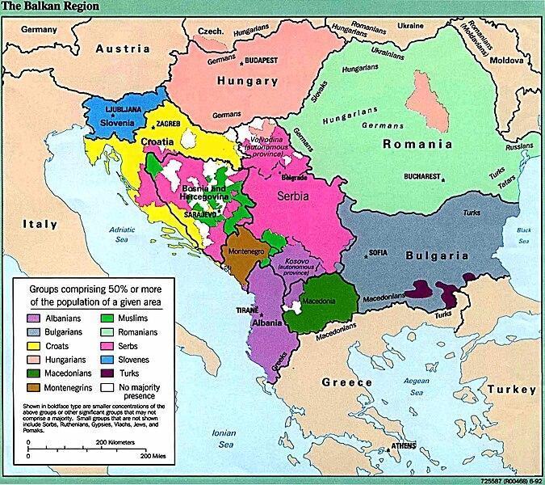
THE BALKAN & THE BOSNIAN CRISIS
Wikimedia: Map of the Balkans
To study the main events of the Balkan & the Bosnian crisis leading to the First World War
Notes:
Give a short introduction on the Balkans, familiarize the map. https://commons.wikimedia.org/wiki/File:Balkans_ethnic_map_(1992).jpg

Slide 3
DRAW AND FILL OUT THE TABLE AS WE MOVE FORWARD
 | Balkan Crisis | Bosnian crisis
What?
Why?
Impact
Notes:
Ask your students to keep filling out the columns – Why did it happen? What happened, and what was the impact?

