Slide 1

www.tweakteach.com
©2025 TweakTeach

Slide 2
AFRICAN KINGDOMS
ASANTE (C.1695 – 19TH CENTURY)
WHY WAS THE ASANTE KINGDOM KNOWN AS THE KINGDOM OF GOLD?
Notes:
The lesson length is approximately 55 minutes. The lesson is part of a scheme of work on African Kingdoms. The learning objective of the lesson aims to provide pupils with substantial knowledge about the socio-economic conditions that prevailed in the Asante during the18th to the 20th century. The lesson could be taught as an independent lesson while covering ancient kingdoms or topics related to Africa. The lesson is suitable for Year 7 and Year 8 while by additing more challenges the lesson can be used for Year 9 as well.

Slide 3
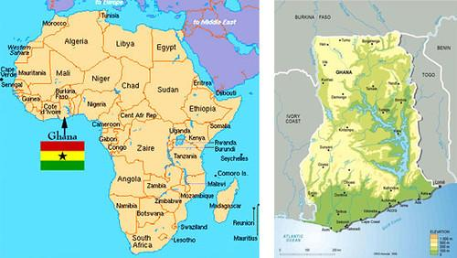
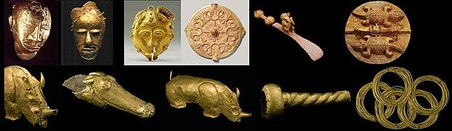
THE KINGDOM OF GOLD
The Asante Kingdom was one of the richest kingdoms that existed in West Africa.
It was located in what today is Ghana
This Photo by Unknown Author is licensed under CC BY
Why was Asante known as the Kingdom of Gold?
Share your thoughts
Wikimedia: Asante Gold

Slide 4
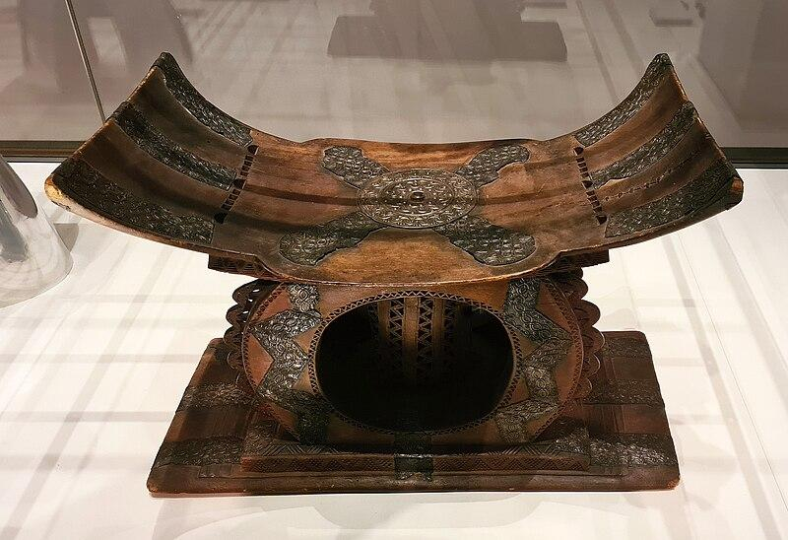
THE LEGEND OF THE GOLDEN STOOL
The Golden Stool was the Throne or the seat of the ruler called the Asantehene
The Golden Stool was a symbol of power
The legend tells the story of the stool descending from the sky onto the lap of Osei Tutu, who was the first Asante King
What was the legend of the Golden Stool?
Write down a short summary of the above.
Wikimedia: A Stool from Asante present in the British Museum

