Slide 1

www.tweakteach.com
©2025 TweakTeach

Slide 2
KINGDOM OF BENIN C. 1500 –C.1750
TO WHAT EXTENT WAS THE TRADE IN ENSLAVED PEOPLE THE CAUSE FOR THE RISE AND FALL OF BENIN?

Slide 3
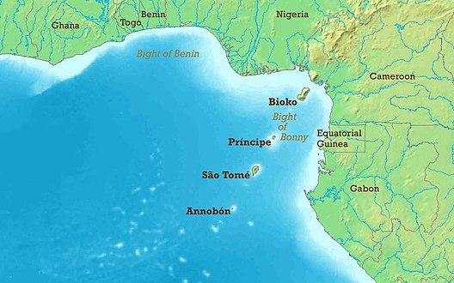
LOCATION AND FEATURES
Benin was a Western African Kingdom and became a part of Nigeria.
The word Oba is associated with the King.
The oral literature provides us with a story related to the first Oba of Benin.
The heart of the empire was its capital at Edo
This Photo by Unknown Author is licensed under CC BY-SA
Circle the location of Benin on the map.

Slide 4
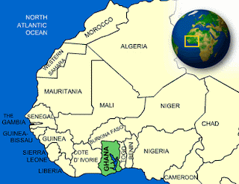
EDO WERE PEOPLE WHO LIVED IN SOUTHERN NIGERIA
According to Edo Oral literature, the people were dissatisfied with the rulers and sent a request to another sacred town, Yoruba, to send a ruler. The divine ruler Ooni sent his son Oranmiyan, and his son Eweka became the First Oba of Benin.
This Photo by Unknown Author is licensed under CC BY-SA-NC

